Slide 1
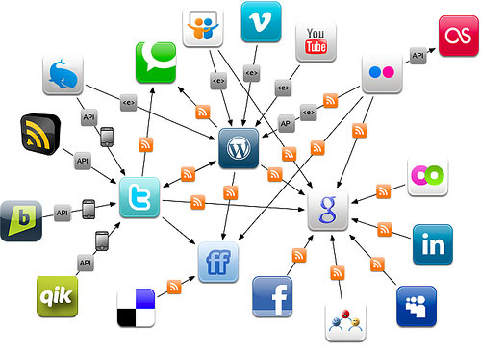
Marketing Communications in Digital Environment…

Slide 2
What digital media has brought…
Dialogic communication
Interactivity
Engagement
Relationship
Speed/Instantaneous communication
User generated content/Customer-centricism

Slide 3
Advantages of Digital Marketing
Cost Effectiveness: digital ads are typically more cost-effective than standard traditional marketing campaigns.
Personal and Customized Messaging: digital marketing allows brands to specify exactly the target demographic for each individual ad in a campaign. Digital media enhance creativity.
Easily Measured and Adjusted: if the campaign is not performing well, most digital ads can be updated much more easily than traditional ads, and are scalable.
Real time results: digital media enable companies to see their numbers of visitors to their site and its subscribers increase, peak trading times, conversion rates and much more at the touch of a button.
Greater exposure: a business can be seen anywhere in the world from one marketing campaign with lower costs than traditional methods

Slide 4
Advantages of Digital Marketing
Mobile-accessible: more and more people are using smartphones and tablets in their day to day lives - digital marketing invites brands to tap into consumers' behavior and reach them seamlessly through mobile devices
Viral Value: brands that post content to social media sites like Facebook, YouTube, and Pinterest are able to plug into consumers who are able (and willing) to share that content with their networks
Not Intrusive: through the power of market segmentation and tailored marketing, online people could choose to be out of communications or not and often it is relevant because they were the ones searching for it in the first place.
Great Engagement: brand/consumer engagement in digital marketing, is all about developing a personalised relationship that reaches the masses but speaks to each individual through relevance and frequency. It goes beyond interactivity and leads to relationship building.

Slide 5
Disadvantages of Digital Marketing
Too much ad clutter
Reputation can be damaged easily by negative feedback.
Highly dependent on technology which can be prone to errors.

Slide 6
Digital ad spent in Turkey for Jan-June 2014…
~4 billion TL
Total ad spent
540 mio TL
Digital Advertising Expenditure
%48: Search Engine Marketing
%45: Display ad
%6: Mobile
Source: rd.org.tr

Slide 7
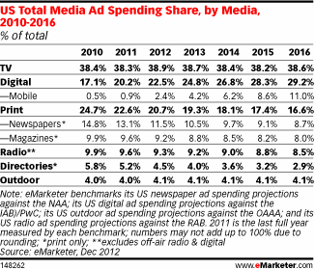
Increasing digital media expenditures…

Slide 8
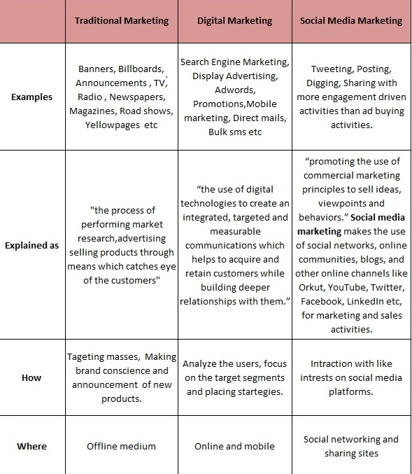
http://marketinomics.com/digital-marketing-2/traditional-digital-and-social-media-marketing/

Slide 9
Marketing Communications in Digital Environment
Digital Advertising
  Display ads (banner, pageskin, e-commerce)
  Pre-roll
  Rich media
  Video
  Adwords
  Retargeting ads
  E-direct ads
  Advergame
Mobile Marketing
Social Media Marketing
  Social media ads
  Social media accounts
  Blogs
  Viral

Slide 10
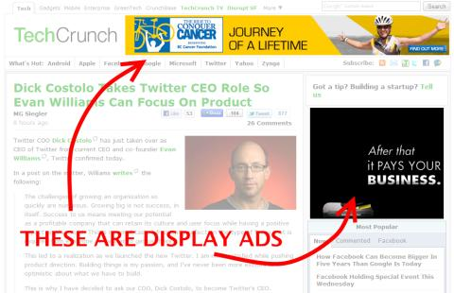
Examples of Digital Advertising
Display Ads (Banner): Image-based advertisements that often appear in the side, top, and bottom sections of websites. They can range widely in terms of size, design, and function

Slide 11
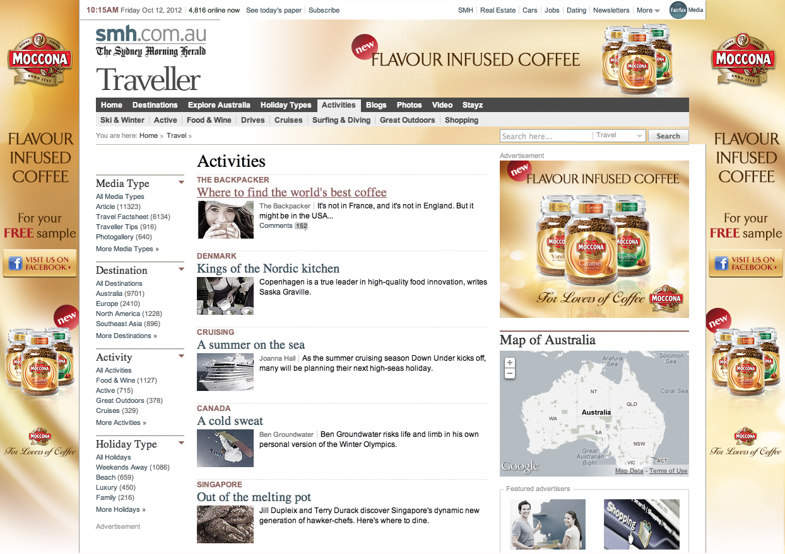
Examples of Digital Advertising
Display ads (Pageskin)

Slide 12
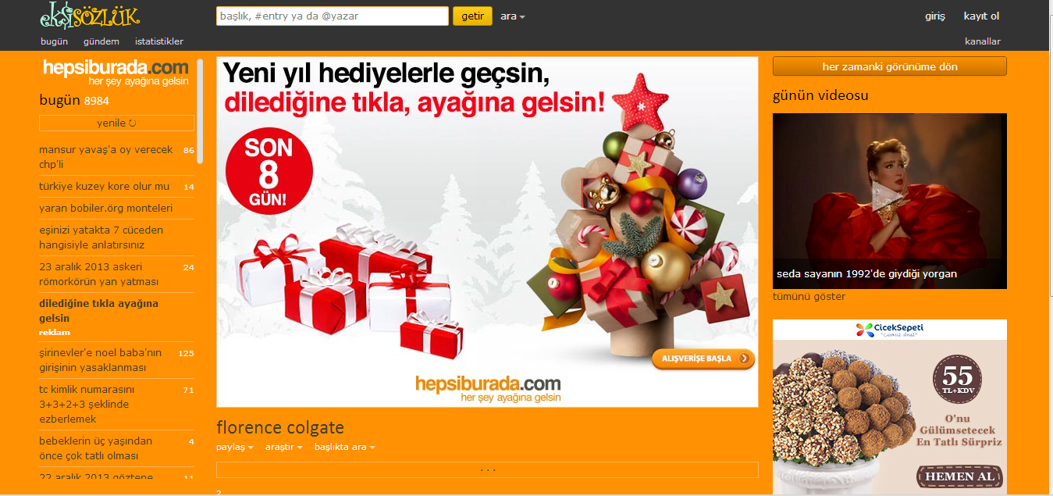
Examples of Digital Advertising
Display ads (E-commerce banner)

Slide 13
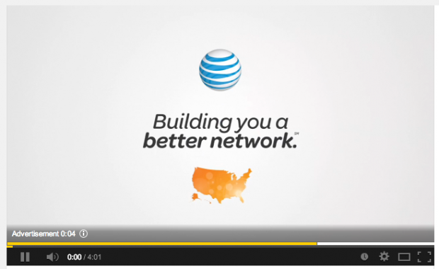
Examples of Digital Advertising
Pre-roll video: Short promotional videos before you could watch a video on YouTube or another video sharing website. Users are forced to sit through at least five to 10 seconds of advertising before they see their desired video.

Slide 14
Examples of Digital Advertising
Rich media banner: Dynamic ad which has audio/video in it.
http://demo.mediamind.com/Creative_zone/Amway_Fall/index.html

Slide 15
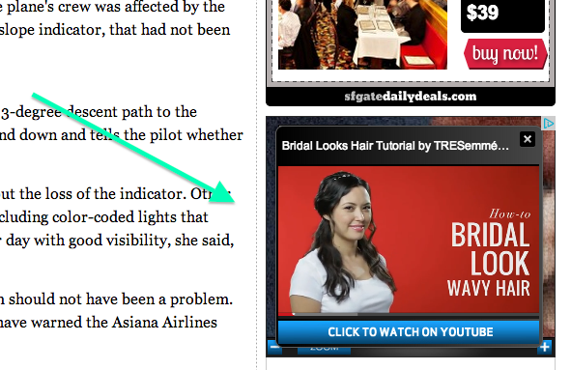
Examples of Digital Advertising
Video ads

Slide 16
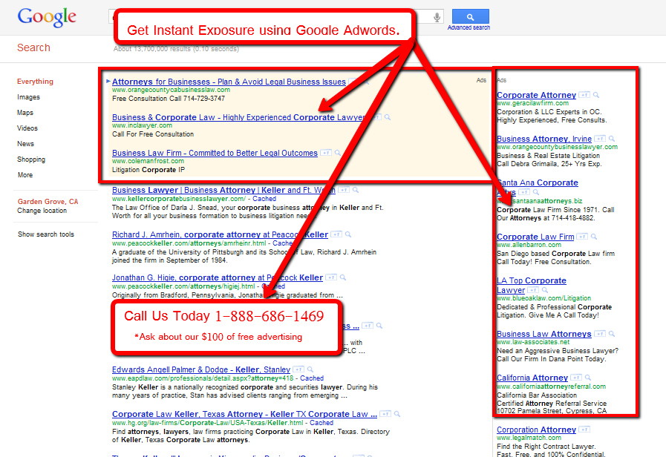
Examples of Digital Advertising
Adwords

Slide 17
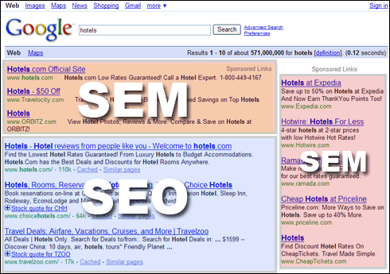
Examples of Digital Advertising

Slide 18
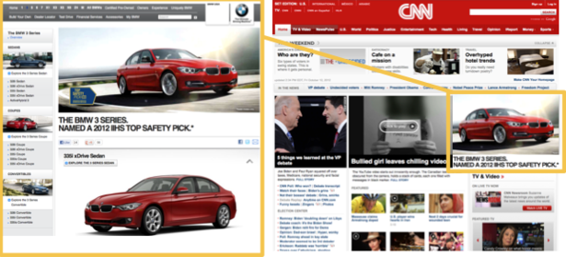
Examples of Digital Advertising
Retargeting Ads: When a user visits a website, a cookie is attached to the visitor, taking note of what pages and products the user visits while browsing the site. Once the user leaves the advertiser’s site and begins journeying to other websites, targetting ads can be made to appear in certain ad spaces, displaying ads that specifically call out what the user was looking at on the advertiser’s site earlier.

Slide 19
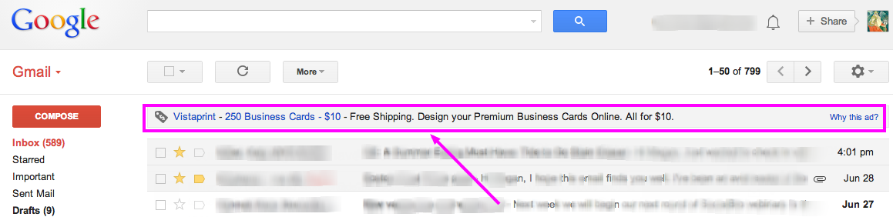
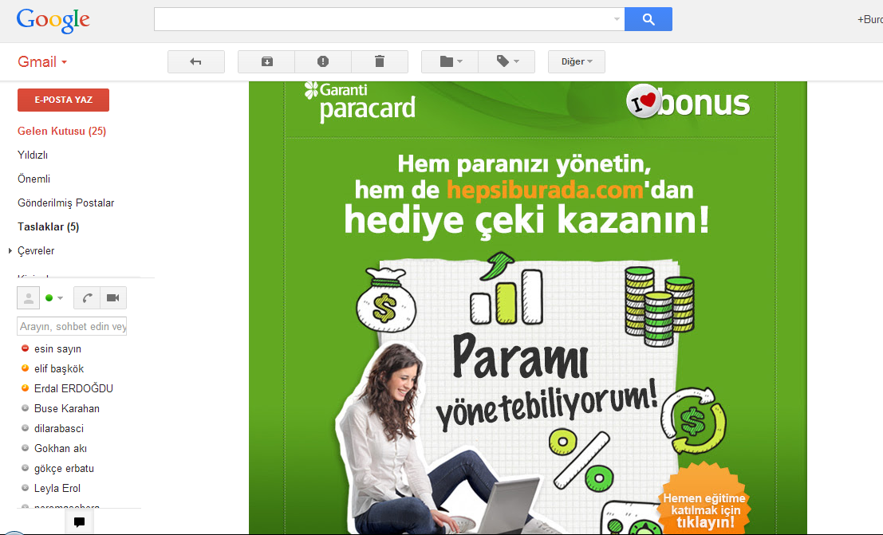
E-direct Ads: Google’s online email service are contextual ads that are generated by an automated process that scans a user’s emails to discover interests and topics that are relevant to the user.

Slide 20

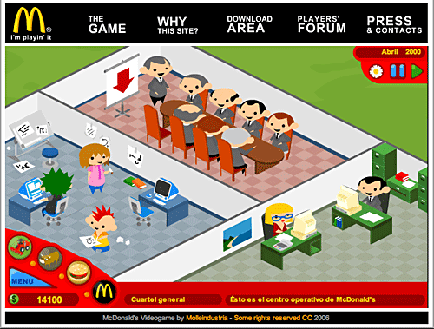
Examples of Digital Advertising
Advergame

Slide 21
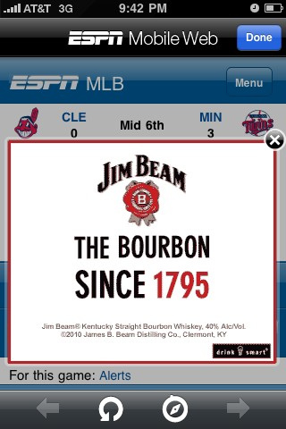
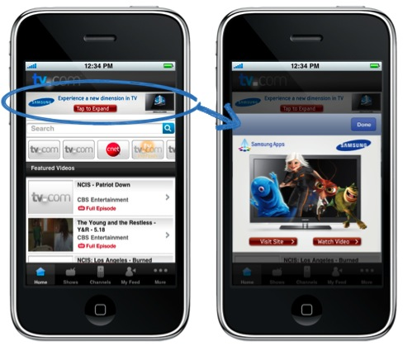
Examples of Digital Advertising
Mobile ads

Slide 22
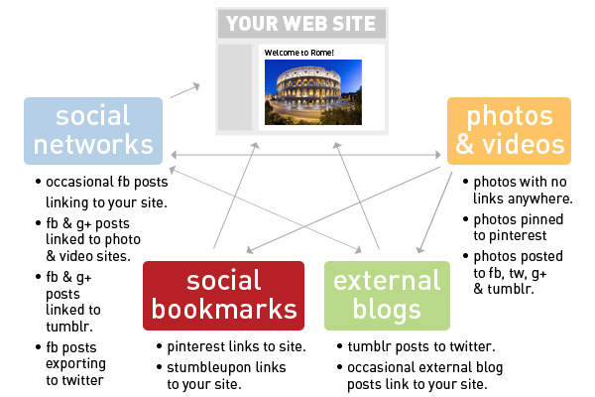
Social Media Marketing

Slide 23
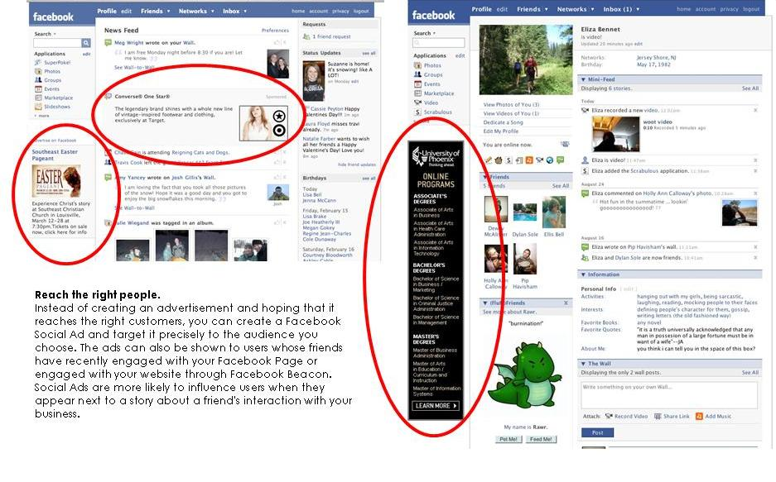
Examples of Social Media Marketing
Facebook Ads

Slide 24
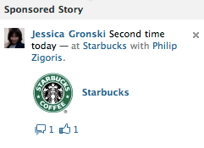
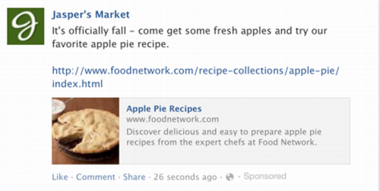
Examples of Social Media Marketing
Facebook Ads
Sponsored Stories show a user’s interaction with an advertisers page or product to the user’s friends and larger network. Sponsored Stories are also one form of Facebook ads that can appear in a user’s newsfeed.
Facebook exchange ads take into account a user’s web surfing history data, letting an advertiser show an ad for a product a user was looking at earlier on the advertiser’s website

Slide 25
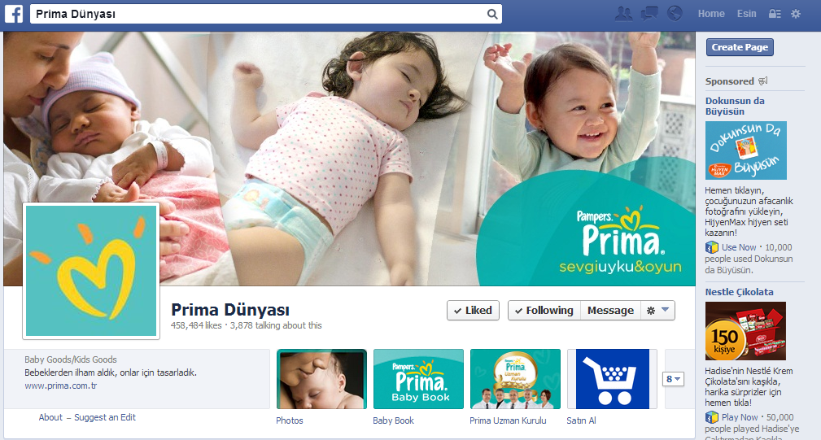
Examples of Social Media Marketing
Facebook account

Slide 26
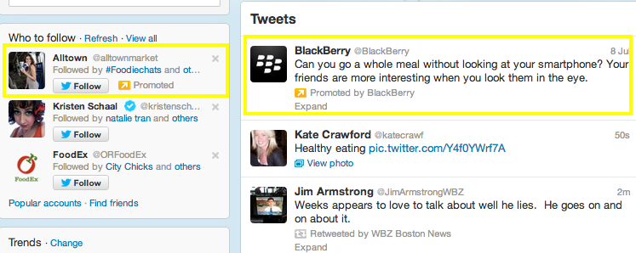
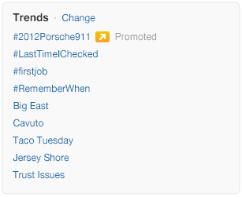
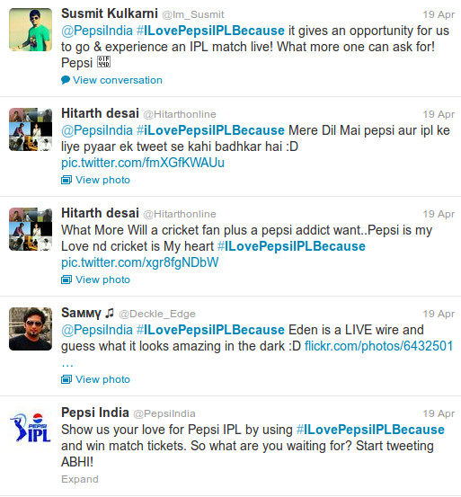
Examples of Social Media Marketing
Twitter Ads: #Hashtag, promoted tweets, promoted accounts, promoted trends

Slide 27
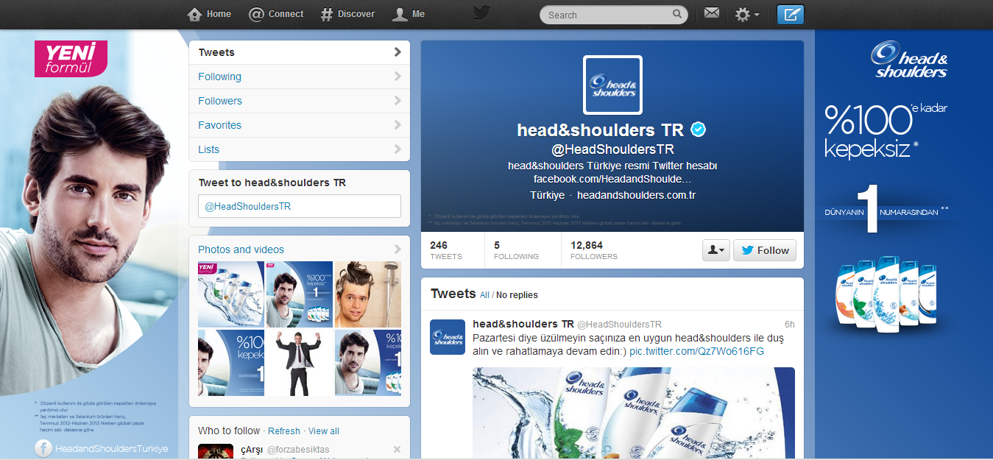
Examples of Social Media Marketing
Twitter account

Slide 28
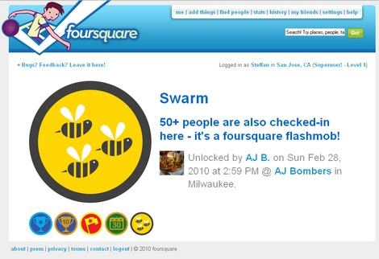
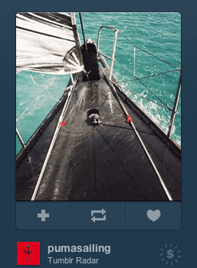
Examples of Social Media Marketing
Foursquare ads
Tumblr ads (Tumblr Sponsors)

Slide 29
Examples of Social Media Marketing
Vine ads, instagram ads
http://blog.brandsonvine.com/
Viral ads

Slide 30
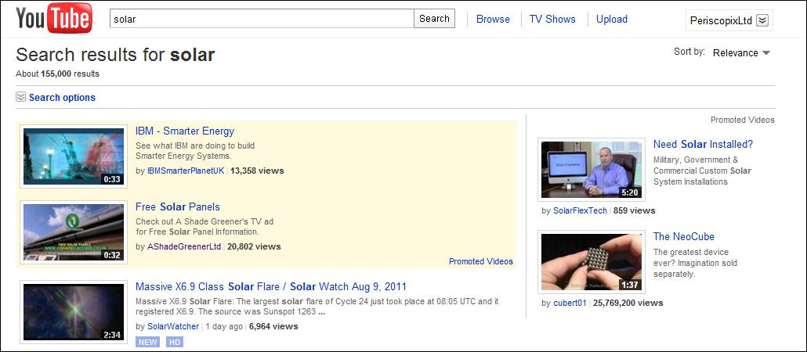
Examples of Social Media Marketing
Youtube ads

Slide 31
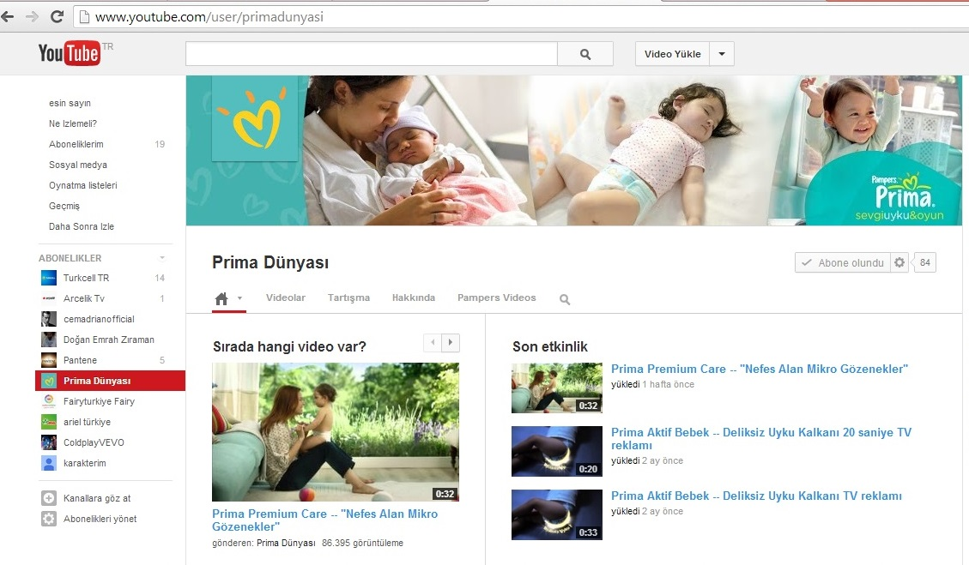
Examples of Social Media Marketing
Youtube channel

Slide 32
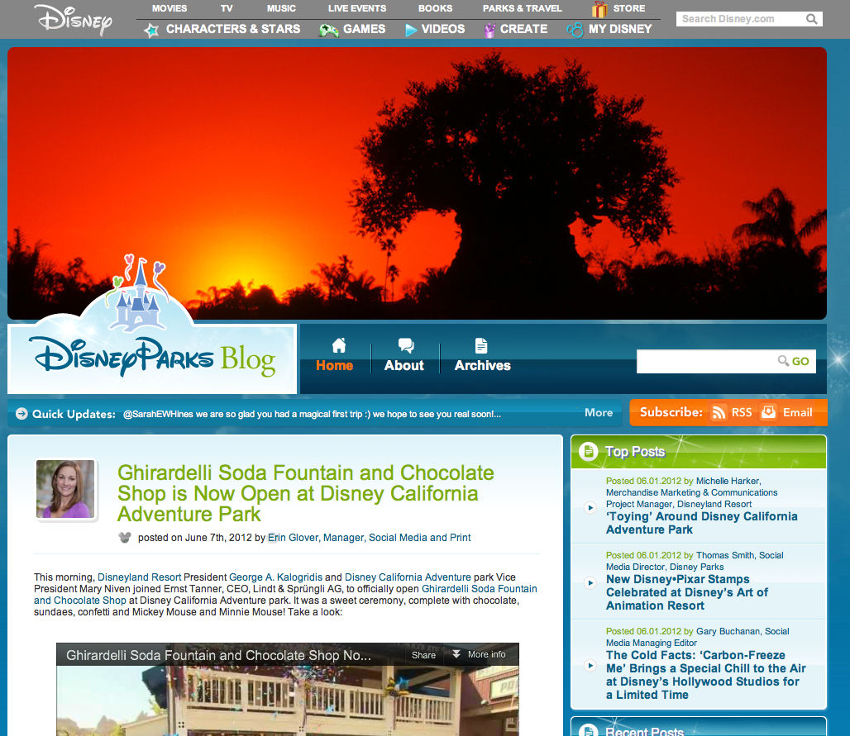
Blogging
Company Blogs

Slide 33
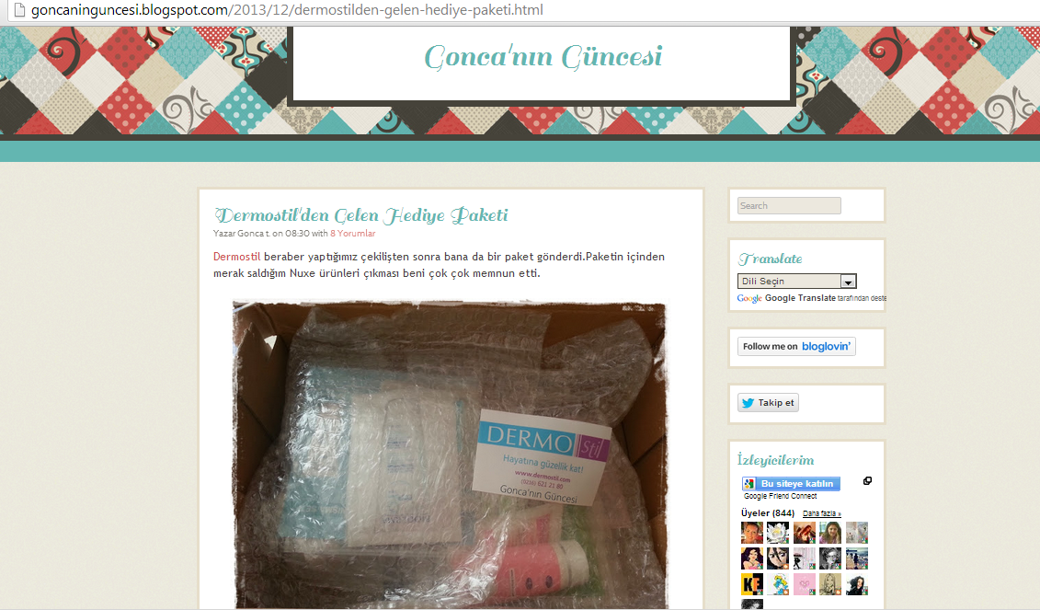
Blogging
Blogger endorsement

Slide 34
More on various formats in digital marketing communications…
https://www.udemy.com/blog/advertising-examples/
http://www.wordstream.com/online-ads#YouTube Ads

