Slide 1
Digital, Interactivity and IMC:
How They All Fit
Together
Don Schultz, Ph.D.
Professor Emeritus-in-Service
Medill Integrated Marketing Communications Dept.
Northwestern University
Izmir University
21 April, 2015

Slide 2
A Natural Question:
What Is Medill IMC?
Part of the School of Journalism, Media and Integrated Marketing Communications at Northwestern University (near Chicago)
Over 650 graduate and undergraduate students enrolled
  300 undergrads in a certificate program
  200 graduate students – full and part-time
  150 online graduate students

Slide 3
Other Affiliated Units
Applied Neuromarketing Consortium – interdisciplinary research center
Retail Analytics Council – research on intersection of online and offline retailing
Omni-Channel Initiative – using software to identify, understand and communicate with consumers
Spiegel Research Center – cooperative research with industry to improve marketing results

Slide 4
What We Teach
Core IMC Concepts
Brands/ Branding
Financial Analysis
Data
Platforms
Market Research
Comm Strategy
Media Mgmt
Consumer Insights
Data Analytics
Content Mgmt
Marketing Mgmt

Slide 5
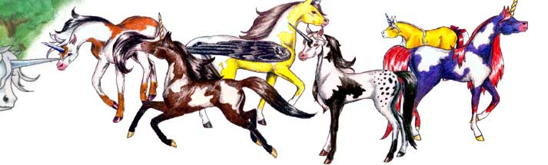
We’re a Group of Hybrid Generalists,
In an Increasingly Specialized World

Slide 6
One Overriding Theme:
Everything Starts With the Consumer/Customer!

Slide 7
Our Curriculum Continues to Expand, Evolve and Change as the Marketplace, Consumers and Technology Develop

Slide 8
A More Scientific,
Than Intuitive Approach to Marketing Communications

Slide 9
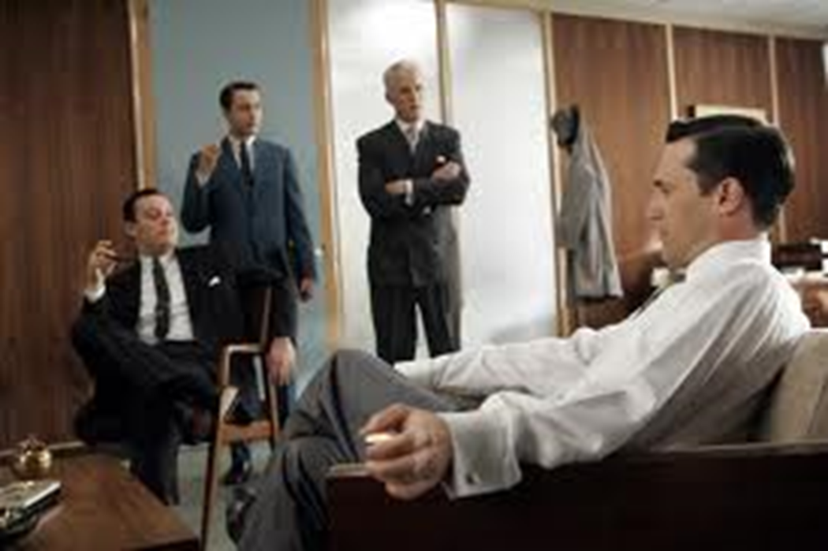
Moving Beyond the
“Mad Men” Era

Slide 10
Conversation/Discussion

Slide 11
How Did IMC Get Started and Why?

Slide 12
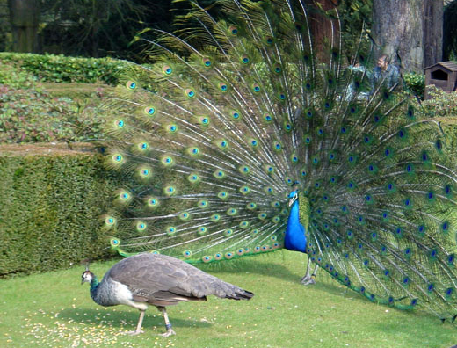
Formal Study Began at Northwestern in 1902…..
But, With Advertising
A study of the innate behavior of the species

Slide 13
Our Historical Roots
Advertising – Walter Dill Scott – psychology professor -published “The Theory of Advertising”, 1903 – later became Northwestern President
Advertising taught at NU since 1905 – a major in the School of Commerce
Marketing came later – 1910 – as a concept, not an activity

Slide 14
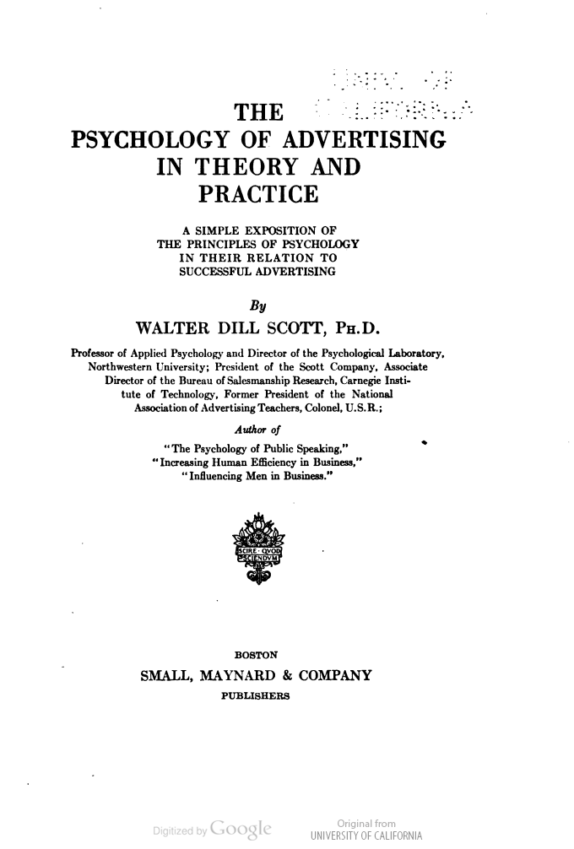
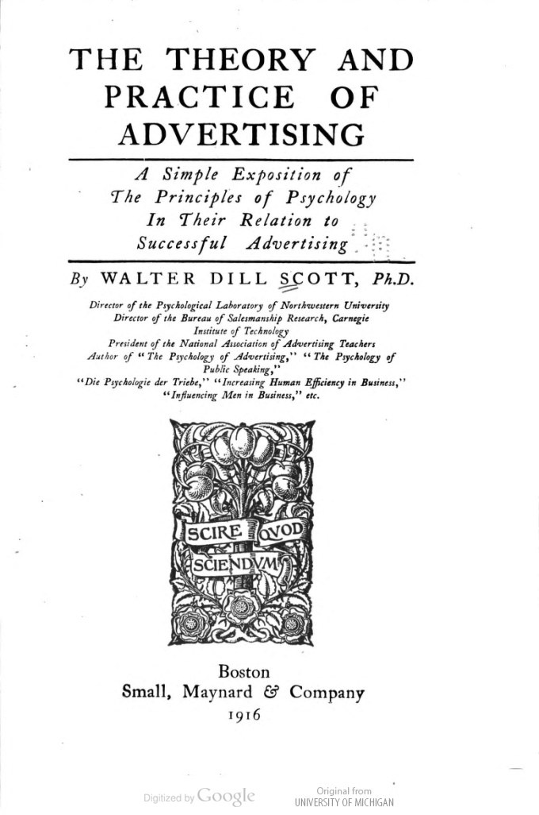

Slide 15
Early 1900s to World War Years…
Advertising Moved from
Building Basic Demand to
Brands and Branding

Slide 16
Advertising: 1940s-1970s
Foundations of today’s advertising practice developed
  Mass communication/media
  Retailing and distribution
  Brand management
  Agency structures
  Consumers as “targets”

Slide 17
In the 1980s, Many Factors Impacted the Field
Advertising….from art to science…. computing and digitalization
Shift of client spending …..from media to sales promotion, direct marketing and PR
Agency consolidation
Growth of MBA-trained business managers
Industry structures…..functional silos

Slide 18
We Got “Disrupted” Out of Our Advertising Niche……
We Couldn’t “Remodel”,
So, We Had to “Re-Invent”

Slide 19
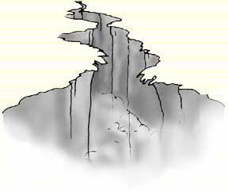
We Crossed the Chasm
“What
Customers
Want”
“What
We Do”

Slide 20
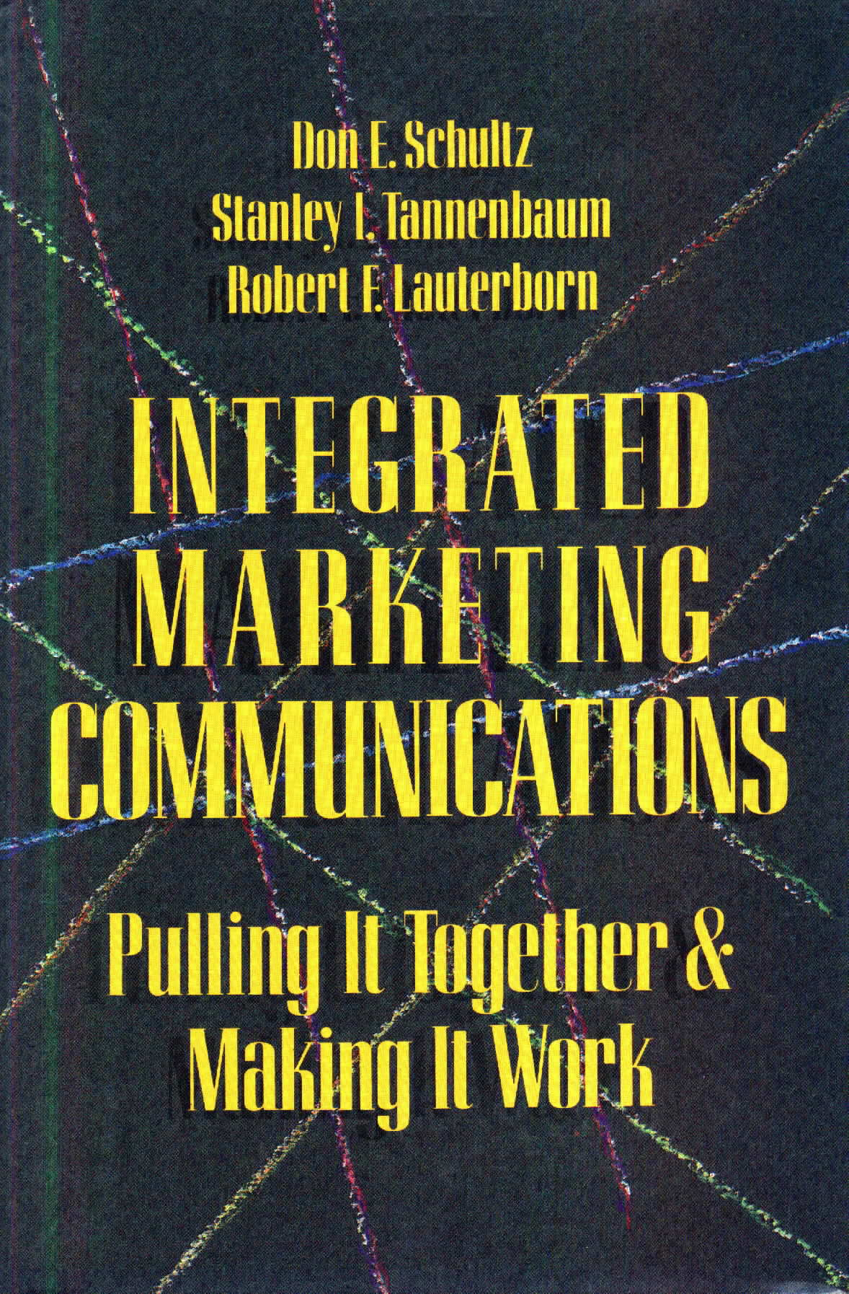
Our First Response to the Changes…

Slide 21
The Subtitle Says It All:
“Pulling It Together and Making It Work”
Inside-out only – still, what we want to do
Focused on four major elements: advertising, sales promotion, direct marketing and public relations – align and coordinate these elements
Create “one sight and one sound for the brand”
Build practical values for marketers (reduced waste) – generate assumed values for consumers (easier to understand the brand)
All before “Interactivity” was even available

Slide 22
That Was “New” to Many Marketers, and, Certainly New to Traditional, Specialized Agencies and Media Firms

Slide 23
The 1990s Produced
“Newer” Versions of IMC
Growth and availability of consumer and retailer data and analytics - digitalization
Increased focus on customers and insights – outside-in approaches
Move toward a “technology base” for marketing and communication” – rise of databases and CRM
Increasing emphasis on measurement and ROI
Globalization and internationalization driven by emerging markets

Slide 24
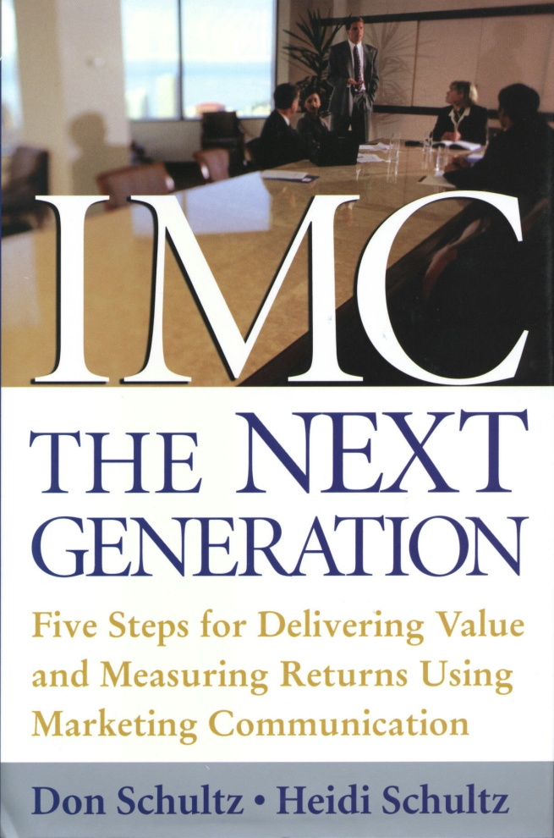
We Defined It as…
IMC: The Next Generation

Slide 25

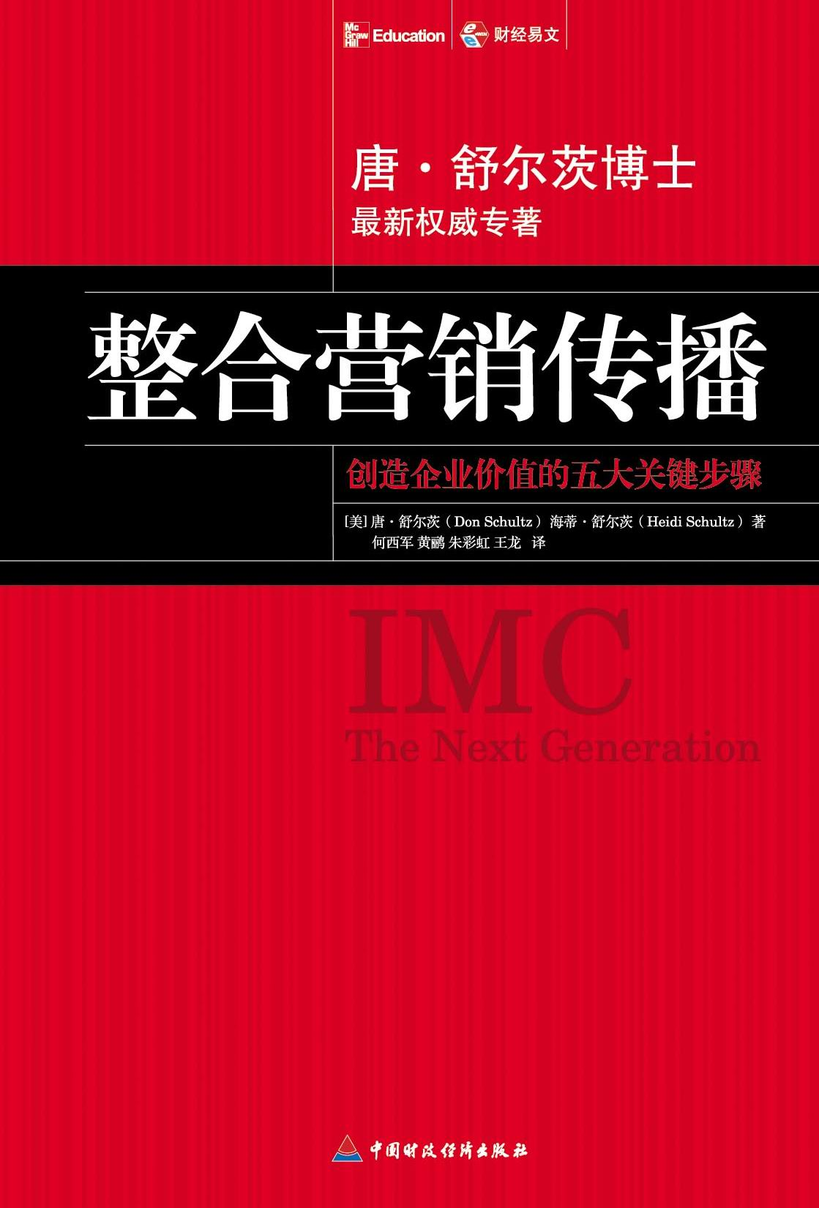
Built Around This Definition….
“Integrated Marketing Communication is a strategic business process used to plan, develop, execute and evaluate coordinated, measurable, shared marketing communication programs over time with consumers, customers, prospects, employees and other relevant external and internal audiences. The goal is to generate both short-term financial returns and build long-term brand and shareholder value.”
Schultz and Schultz (2014)
Notes:
25
25
IMC in Today’s “Push-Pull” Marketplace
Copyright Agora, Inc. 2009. All rights reserved.
25
Copyright Agora Inc. 2010. All rights reserved.
Using Next Generation Marketing to Speed Up Business

Slide 26
And, This 5-Step Integrated Marketing Communication Process
1. Customer Identification
From Behavioral Data
5. Budgeting, Allocation, Evaluation &
Recycling
2. Valuation of
Customers/
Prospects
IMC
4. Estimating Return-
on-Customer- Investment
3. Creating & Delivering
Messages & Incentives

Slide 27
Emphasis Was on…
Strategic, outside-in approaches to marketing and communication development
Building communication processes – replicable, forward-looking approaches
Focus on measurement and accountability
Moving communication up in the corporate hierarchy – expand planning

Slide 28
That Was the “Newer” Stage

Slide 29
IMC Continues to Evolve,
But,
Based on Some Key Principles That Have Emerged

Slide 30
The Key IMC Concepts
Customer Focus
Interactive Communications
Stakeholders
Message Consistency
Brand Focus
Relationships
Synergy
Financial Investments and Returns
Reciprocity
Contact Points
Cross-Functional Management
Continuous Planning
Moriarty and Schultz, 2010

Slide 31
Discussion/Conversation

Slide 32
Everything Was Wonderful!
Then,
1994
Digital and “The Internet”
Technology Changed the Marketing World…..
Forever!
Notes:
32
Strategic Marekting Communication and IMC
Copyright, Agora, Inc. 2009. All rights reserved
32
IMC in Today’s “Push-Pull” Marketplace
Copyright Agora, Inc. 2009. All rights reserved.
32

Slide 33

Information Technology Gave Consumers Control
Internet – WiFi
Mobile Telephony
Consumer
iPods/MP3 -- podcasts
Social Networks
Cable/satellite
Blocking Systems - TIVO/DVRs/ Filters/Pop-up Blockers/etc.

Slide 34

Consumers Are Now Armed with Two Powerful Tools……
Pictures and Voices

Slide 35
And, Much of It Is on
“The Cloud”
Okazaki, Shintaro “Fundamentals of Mobile Marketing: Theories and Practices”

Slide 36
So, We’re Reinventing Ourselves…..Again!

Slide 37
Starting with This:
Consumers Inhabit a
Multi-Dimensional World
They are continually and consistently changing
Trying to hold them static is useless
Yesterday and curated data are irrelevant factors

Slide 38
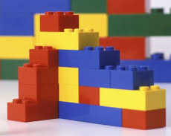
But, Marketers Have Created
A Linear World ….
Like Legos

Slide 39
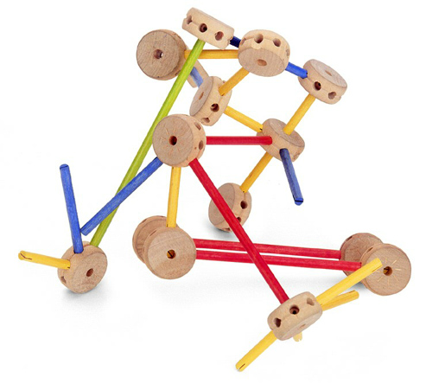
Consumers Live in a
Multi-Dimensional World…
Like Tinker-Toys

Slide 40
Our Present Tools and Techniques Just Don’t Fit…. and Worse,
They Often Don’t Work!

Slide 41
So,
Most Outbound Communication “Push” Models Are Out of Date and Irrelevant

Slide 42


The World Marketers Still Try to Control
Web Search
Competitors
Competitors
Agency → Media → Sales Force
Products and Services
Employees/Recommenders/Friends/Influencers
Customers/
Prospects
Marketer
Messages and Incentives
Competitors
Competitors
Word-of-Mouth New Forms of Media
Notes:
42
Strategic Marekting Communication and IMC
Copyright, Agora, Inc. 2009. All rights reserved
42
IMC in Today’s “Push-Pull” Marketplace
Copyright Agora, Inc. 2009. All rights reserved.
42

Slide 43
Ignoring Consumer Demand for “Real-Time” Responses

Slide 44
What to Do?

Slide 45
Discussion/Conversation

Slide 46
What’s Needed?

Slide 47
1. New Business Models

Slide 48

Traditional 4Ps
Supply-Chain Model
Agents &
Brokers
Distributors
Retailers
Assembly
Batch/line/Continuous
process
Suppliers
Raw material
Final Packaging
Manufacturer
Customers/End Users
Notes:
48
IMC in Today’s “Push-Pull” Marketplace
Copyright Agora, Inc. 2008. All rights reserved.
48

Slide 49
Start With Customers to be Served,
Not Products or Services to be Sold!

Slide 50

Customer-Driven
Demand-Chain Model
Marketing/
Sales
Appropriateness
of Solution
Marketing/
Sales
Solution
Seeking:
Wants/
Needs/
Desires
Recognized/
Unrecognized
Knowledge of Solution
Production
Considerations
Market Planning
Value/Sacrifice
to Obtain
R & D
Access to
Solution
Admin
Customers/End Users
Intermediaries
Notes:
50
IMC in Today’s “Push-Pull” Marketplace
Copyright Agora, Inc. 2008. All rights reserved.
50

Slide 51
2. New Communication Models

Slide 52


Abandon Western Psychological/Attitudinal Approaches
One-Way
Attitudes/
Awareness
Purchase
Behavior
Marketing
Communication
Knowledge
Preference
Conviction
Linear
“Influencing and Persuading Consumers”
Source: Adapted from Lavidge and Steiner
Notes:
Integrated Marketing Communications in a “Push and Pull” Marketplace
Copyright 2009, Agora, Inc. All rights reserved.
52
IMC in Today’s “Push-Pull” Marketplace
Copyright Agora, Inc. 2009. All rights reserved.
52

Slide 53

Recognize Communication Is Networked, Dynamic and
Non-Linear

Slide 54
Remember Our
Multi-Dimensional Example …

Slide 55
In a Networked World,
Behavioral Measures of Customer Performance
Customer income flows
Aggregated into customer value
Tracked and measured over time
Customers treated as investments and returns
Then, re-invested to retain present customers and gain new ones

Slide 56
3. New Organizational Models

Slide 57
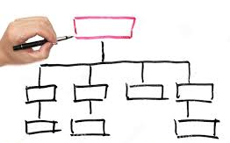
Most Organizations Are Still Based on
“Command and Control”
Lines and Boxes

Slide 58
Organizational Silos That Ignore Customers and Prospects
CEO
Marketing
Sales
Country C
Region X
Marketing
Sales
Human
Resources
IT/Digital
Operations
Source: Adapted from Cranfield School of Management
Notes:
58
Copyright Don Schultz 2008. All rights reserved.
58
Communication and Brands in The New Economy
Copyright Agora, Inc. 2008. All rights reserved.
58
58

Slide 59
Needed: Horizontal Planning Processes That Focus on the Customer
CEO
Marketing
Finance
Sales
Information
Technology
Operations
Customers
Strategy Development Process
Value Creation Process
Channel Management Process
Information Management Process
Performance Management Process
Source: Adapted from Cranfield University

Slide 60
Where We’re Headed

Slide 61







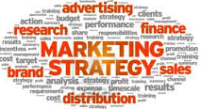
Planning in Real Time
Network #1:
Customers
Network #2:
Data
Network #3:
Analytics
Network #5:
Communication Delivery
Network #4:
Marketing Planning

Slide 62
Using a Consumer-Focused Response Model
S
I
V
A
Solution(s) – Customer Pain Relief
Information – Sorted and Supplied
Values – Input and Outcomes
Access – Client’s Where and When
Notes:
Integrated Marketing Communications in a “Push and Pull” Marketplace
Copyright 2009, Agora, Inc. All rights reserved.
62

Slide 63
That’s Where We’ve Been,
Where We Are Now, and
Where We’re Headed

Slide 64
I’ll be Here All This Week, Let Me Know If You’d Like to Discuss This Further

Slide 65
If you want to chat, contact me at
Don E. Schultz Ph.D.
dschultz@northwestern.edu
Notes:
65

