Slide 1
Integrated Marketing Communication On The Global Stage
Heidi Schultz
21 April 2015
Izmir University of Economics,
Department of Public Relations and Advertising

Slide 2
A Little About Me
Education
  BS in Journalism, University of Southern California
  MBA, Kellogg School of Management, Northwestern University

Slide 3
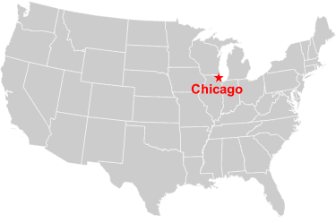
What Do You Know About Chicago?

Slide 4
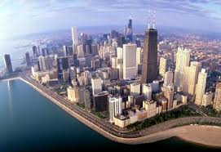
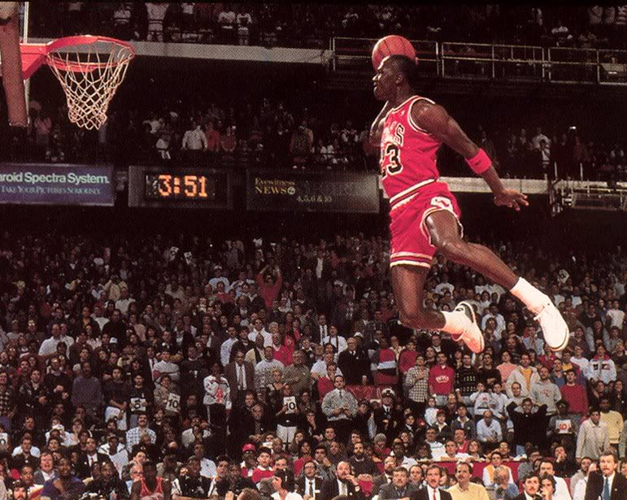
Chicago Is Known For ……

Slide 5
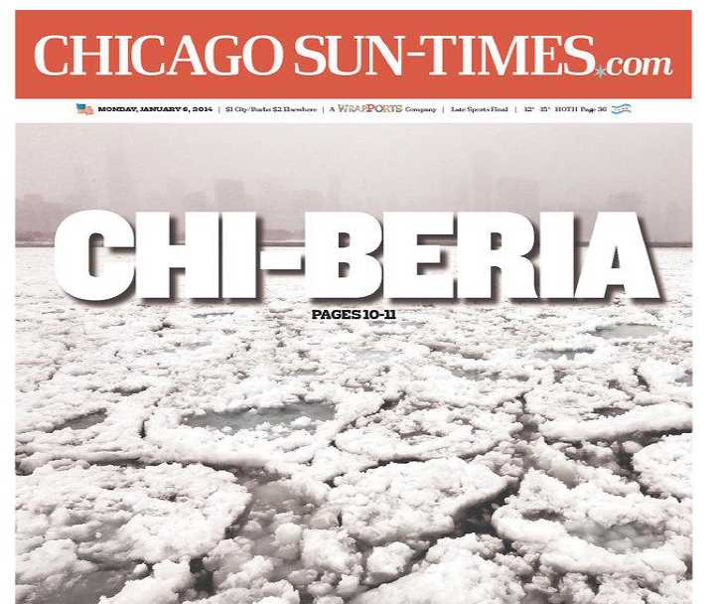

Slide 6

A Little About Me
Professional experience
  First job: COPYWRITER!

Slide 7
A Little About Me
Professional experience
  First job: COPYWRITER!
Magazine management
  Promotion, research
  Circulation management
Publisher
  CHICAGO magazine

Slide 8
A Little About Me
Professional experience
Consulting
Teaching, seminars
  Northwestern University
  Dept. of Integrated Marketing Communication
Guest lecturer/seminar leader
  China, Australia, England, Finland, Brazil, Mexico, Russia, Austria
Books and articles

Slide 9
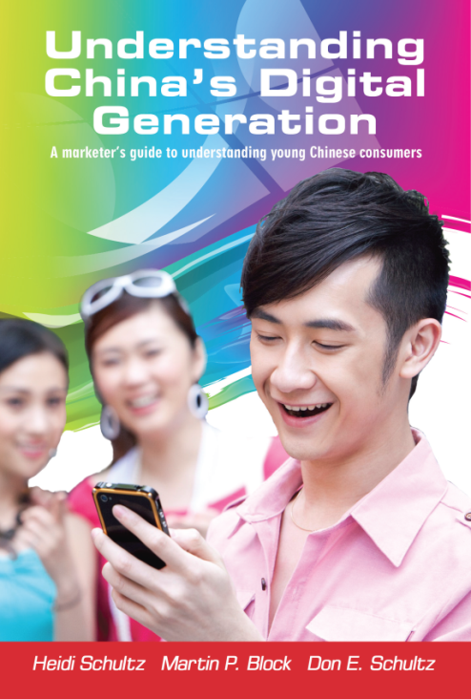



Books on Marketing Communication

Slide 10
Today’s Topic:
Global Brands,
Local Messages

Slide 11
But First, Let’s Review the Fundamental Requirements of Effective Brand Messages

Slide 12






The “5Rs” of IMC
Relationship
Response
Recognition
Receptivity
Relevance

Slide 13
Relevance
  What are the solutions or benefits which customers are seeking?
  Focus on their needs, not product features

Slide 14
Needs, Features Benefits
Features:
Physical properties or characteristics
Benefits:
Outcome when a brand feature meets a customer need
Needs:
Solutions sought by the customer

Slide 15
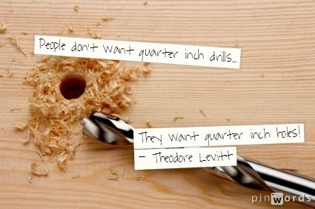

Slide 16
Receptivity
  Reach them where they will be most receptive to or accepting of communication efforts
    Stages in lifecycle
    Anticipation of need or desire
    Points of contact

Slide 17
Recognition
  Make sure they can recognize the brand
  Use memorable name, logo, characters, slogans

Slide 18

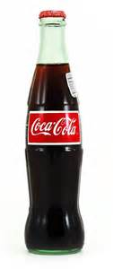
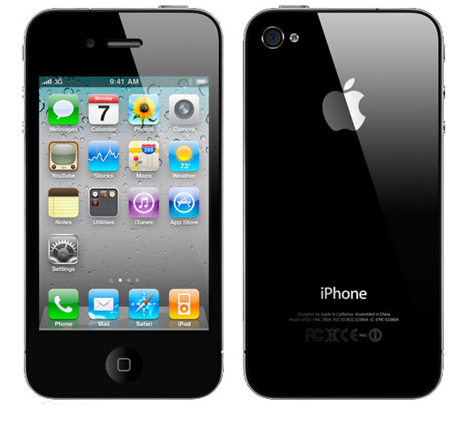

Creating A Recognizable and Differentiated Brand Identity

Slide 19
Response
  Make it easy for them to respond to the offer or store the information away for future use.
  Respond quickly to inquiries and social media activities

Slide 20
Relationship
  Interactive communication to build a strong and lasting relationship with them over time.
  Use of digital media to maintain contact, encourage feedback and co-creation

Slide 21
How Are These Principles Applied In Global Communication?
What to maintain from the home market?
What to adapt to local tastes and needs?

Slide 22
Balancing Tension
Adjustment of several inter-related, often complex matters …..
  Brand identifiers (name, visuals)
  Brand positioning/meaning
  Product features or attributes
  Pricing
  Packaging
  Mess ageing

Slide 23
Balancing Tension
Adjustment of several inter-related, often complex matters …..
  Brand identifiers (name, visuals)
  Brand positioning/meaning
  Product features or attributes
  Pricing
  Packaging
  Messaging

Slide 24
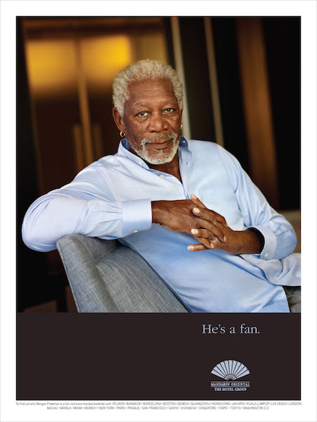
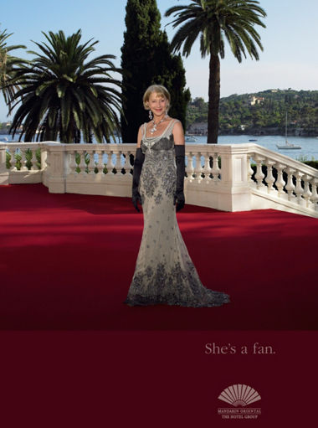
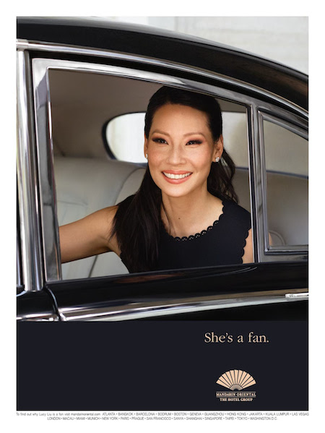
Some Brands Must Maintain Consistency Around the World

Slide 25
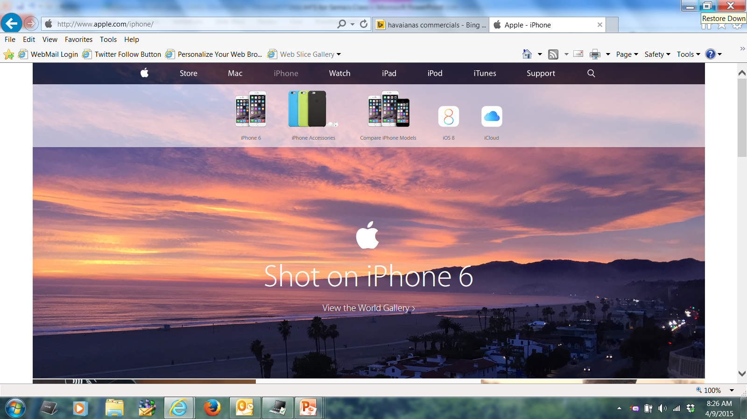

Slide 26
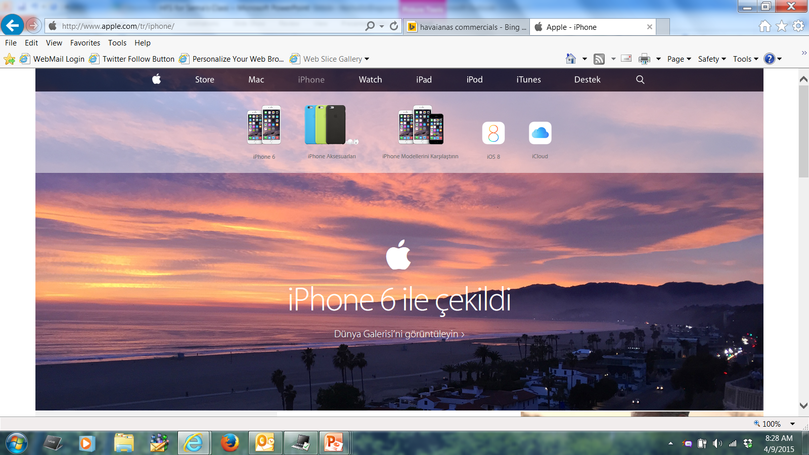

Slide 27
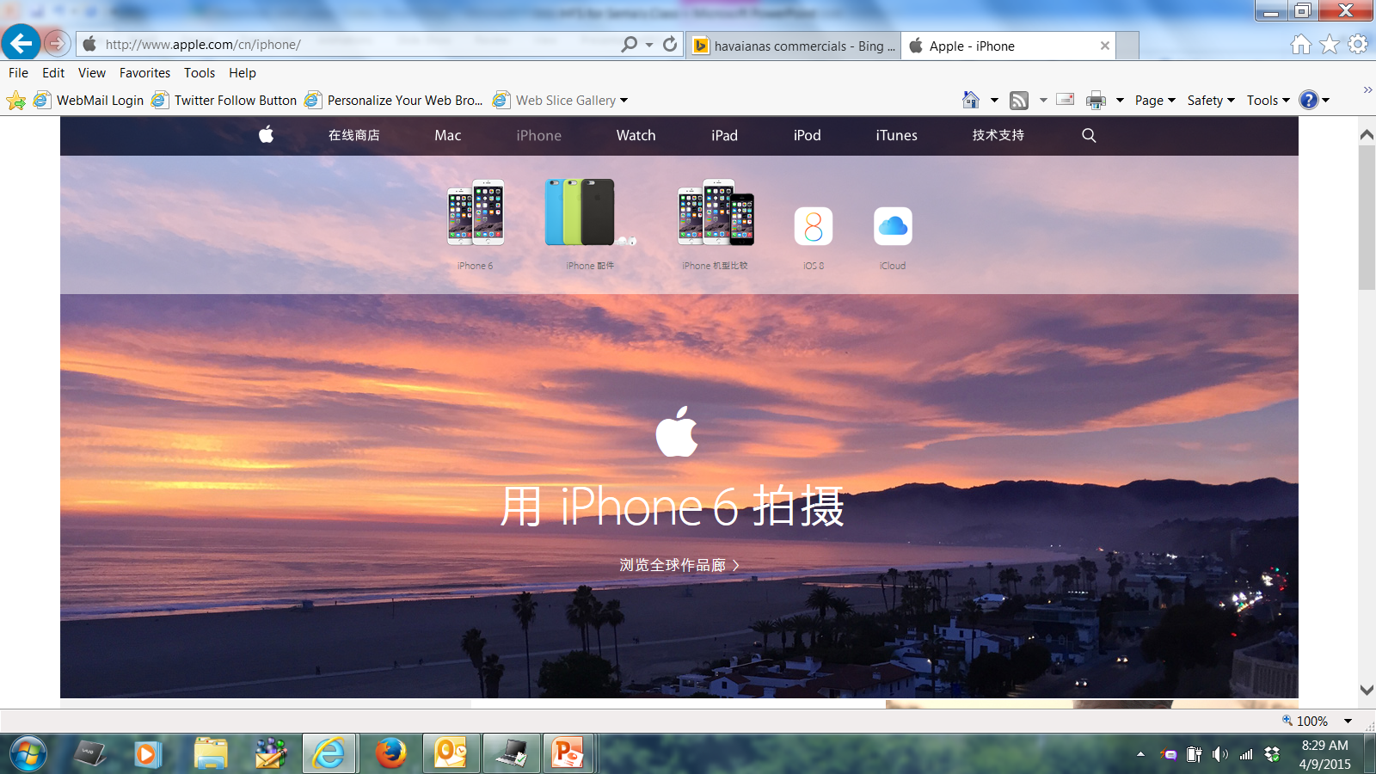

Slide 28
Other Brands Must Adapt To Local Needs, Tastes, and Traditions
Here are a few examples…..

Slide 29
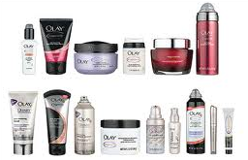
Example: Oil of Olay
Core Brand Promise:
  “A woman’s ally in the fight against aging”

Slide 30
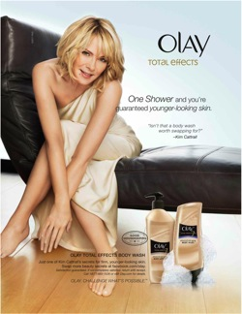


Slide 31
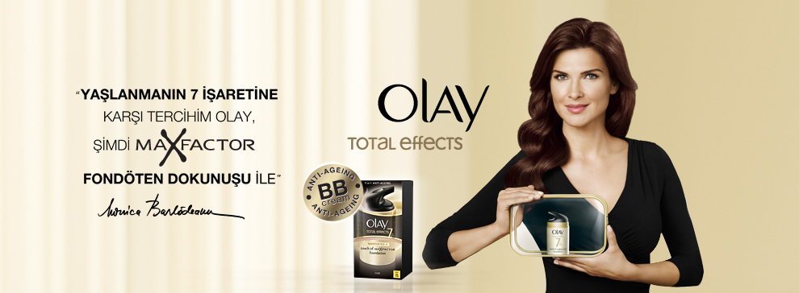

Slide 32
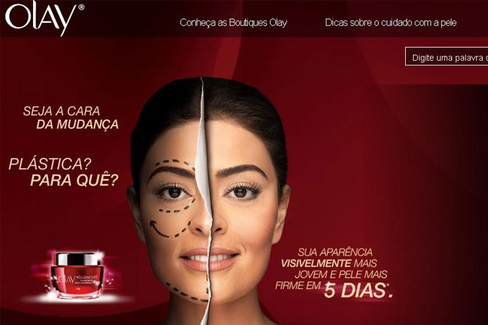

Slide 33


Slide 34

Relationship
Response
Recognition
Receptivity
Relevance

Slide 35
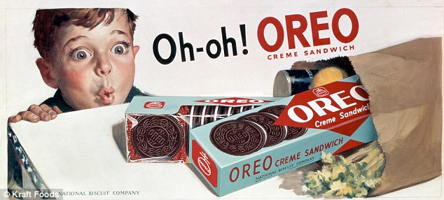
Example: Oreo Cookies
Oreos Cookies – 100 year old American cookie brand, owned by Kraft
Round, black cookies with a white crème center
Introduced into China in 1996
  Little success in first 9 years

Slide 36
Adapting Oreos In China
Chinese thought Oreos too sweet, too bitter
Package of 14 cookies too expensive
Mothers interested in getting children to drink milk
And in sharing precious fun moments with children

Slide 37
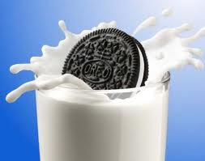
Adapting Oreos In China
Reformulated recipe to be more appealing to Chinese tastes
Repackaged in smaller sizes and lower price point
Tied to an American tradition of pairing milk and cookies
Introduced Oreo’s tradition of “twist, lick, dunk”

Slide 38
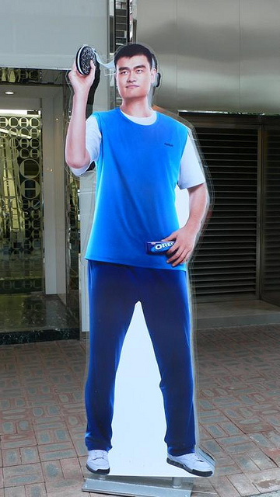
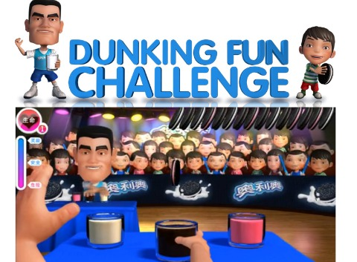
The Campaign (continued)
Hired Yao Ming as a spokesman
  TV commercials
  Events
  Computer games mother and child could shares
http://www.youtube.com/watch?v=TNOqyRBphA4

Slide 39
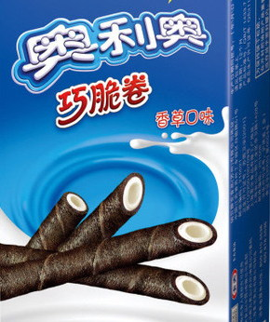
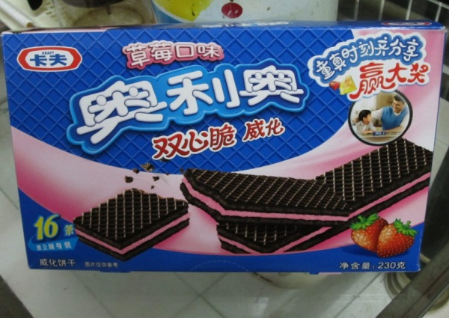
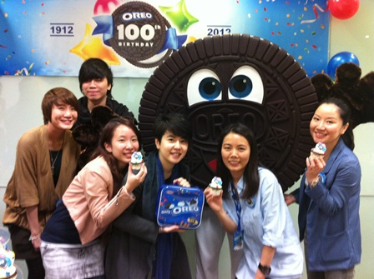
Results
In 1st 7 weeks, Oreo shipments increased by 36%
In 1st year, Oreo revenue doubled
Kraft built on success to introduce additional flavors and shapes
By Oreo's 100th anniversary in 2012, Oreo had become the best selling cookie in China

Slide 40
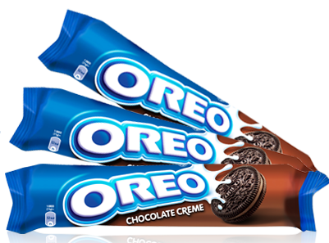
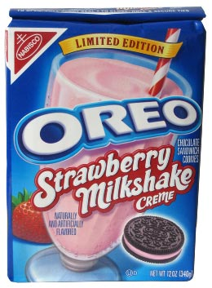
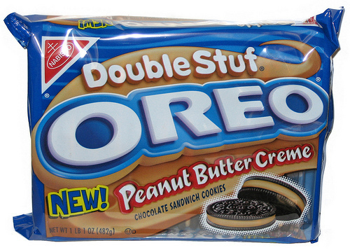
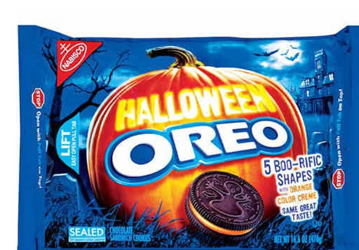
Lesson Learned in China Aided Brand Expansion Around the World

Slide 41
Here Is How They Applied The Insight in Turkey ….
https://www.youtube.com/watch?v=3g6ofTq_DdU

Slide 42

Relationship
Response
Recognition
Receptivity
Relevance

Slide 43
There Are Special Challenges Faced By Emerging Market Brands
Getting recognition
Gaining respect
Building sufficient scale

Slide 44
An Example From Brazil …
Not high tech
Not high fashion
Seemingly copied all over the world
Yet maintains a significant price premium

Slide 45



Slide 46
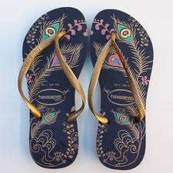
Slow-down in the 1990’s prompted a rethinking of line
  Revamped product with new styles, colors
Began to export to Hawaii and Australia (i.e. beach cultures)
2002 began careful, structured expansion to US, Asia and Europe
Brand attributes: irreverent, colorful, fun
Strong buzz marketing -- adopted by tourists and celebrities
Strong anti-counterfeiting measures

Slide 47
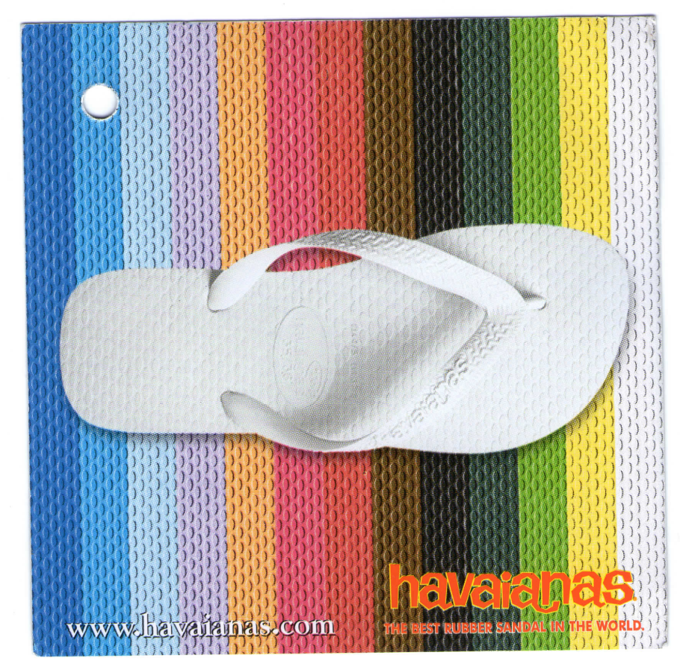
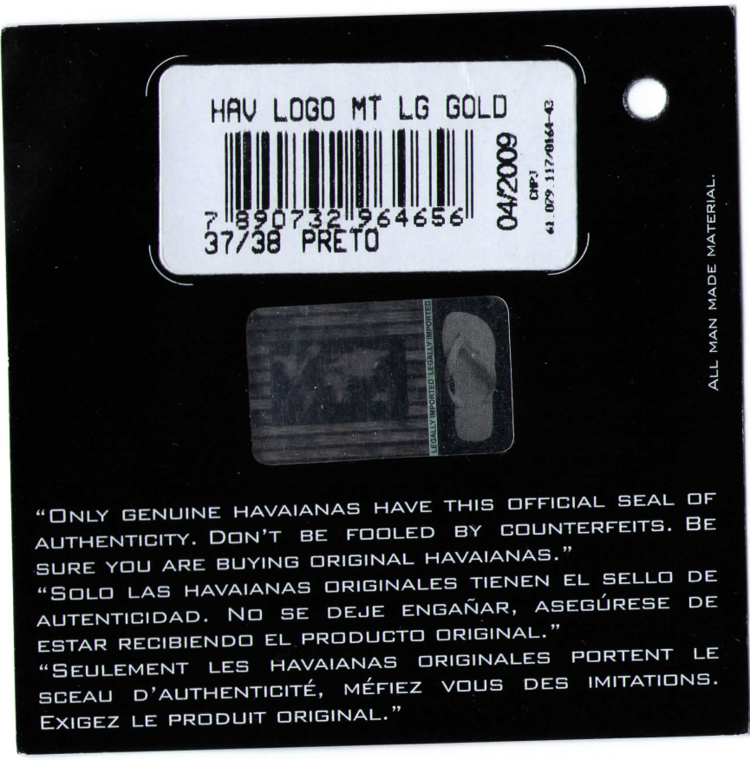
Anti-counterfeiting hologram
47

Slide 48
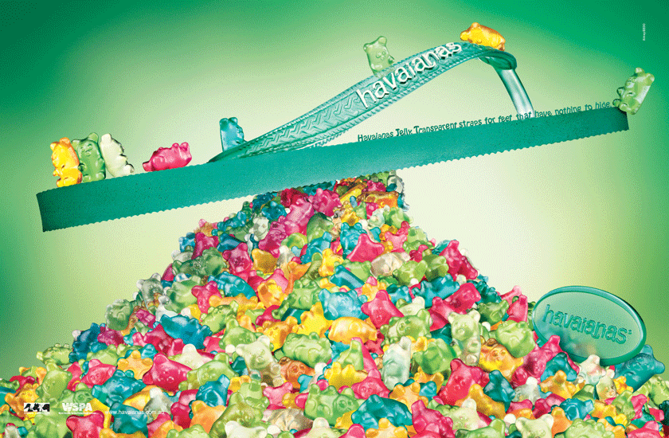
Havaianas Jelly Ad

Slide 49

Havaianas Slim

Slide 50
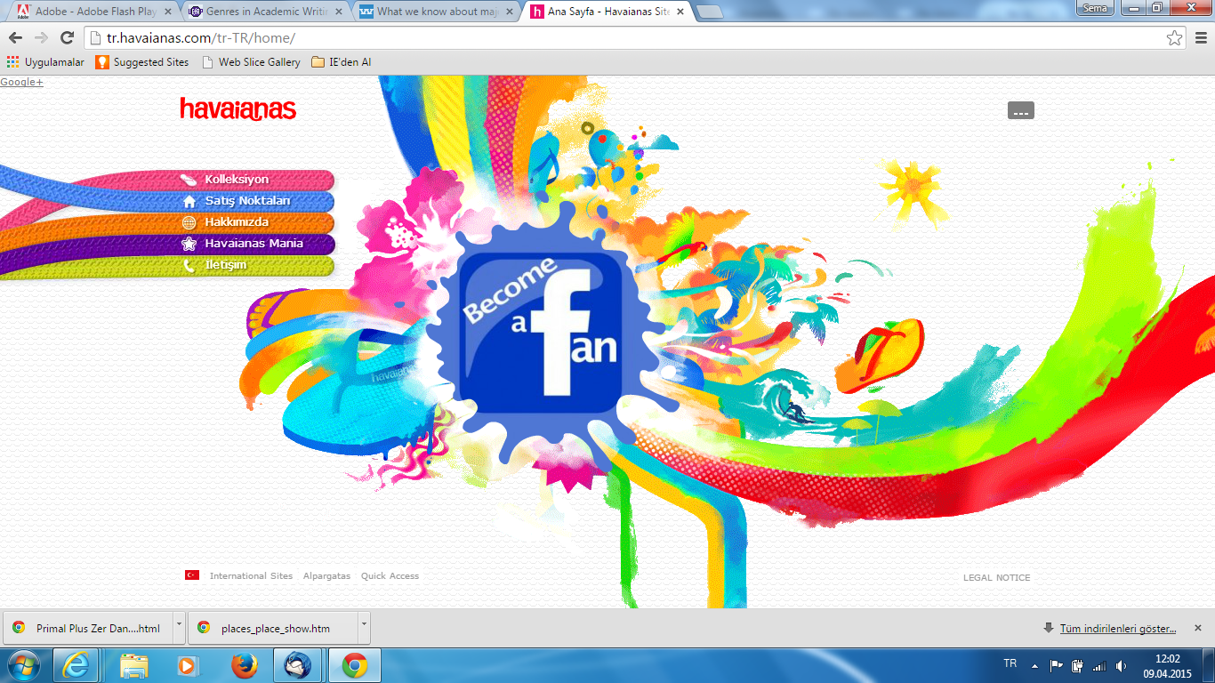
http://www.bing.com/videos/search?q=havaianas+commercials&FORM=VIRE11#a

Slide 51
Prices for Rubber Thongs
Manly, Australia
(in $$ AUS)
Sun Shark
Rip Curl
Mambo
Roxy
Quicksilver
Billabong
Haviannas
$4.99
$19.99
$19.95
$15.95 - $29.99
$17.95-$19.95
$19.95 - $$29.95
$19.95 - $39.95

Slide 52
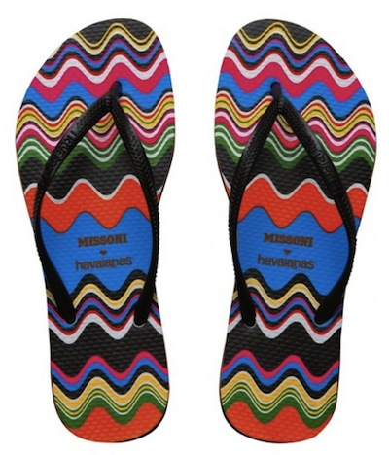
More Recently …
Special edition Havaianas-Missoni
$70 at Bloomingdale’s and Nordstrom’s

Slide 53


Havaianas now sold in 85 countries; revenue $550+ million
850 pairs per 1,000 Brazilians sold annually
8% average sales growth last 15 years
Spends 13-14% of revenue on marketing support
Brand Finance places value of brand at $220 million US
Goal: 35% international sales by 2015

Slide 54
Relationship
Response
Recognition
Receptivity
Relevance

Slide 55
Creative Ideas ….. Well Executed and Carefully Delivered … Can Take Even Small Brands To The Global Stage

Slide 56
Thank You For Your Time, Attention and Participation

Slide 57
Contact Me If I Can Help:
Heidi Schultz
h-schultz@northwestern.edu

