Slide 1
Chapter 1
Welcome to the World of Advertising
Outline
The world of advertising
  Definition
  Components
  Roles
  Functions of advertising
Players of advertising
Types of advertising
Background of today’s advertising
Current advertising issues

Slide 2
The World of Advertising
Defining advertising
  A paid persuasive form of communication
  that uses non personal mass media as well as interactive media
  to reach target audience
  with an identified sponsor

Slide 3
The World of Advertising
Defining advertising
It is a form of communication that operates with objectives and strategies leading to various types of impact on consumer thoughts, feelings, and actions.

Slide 4
Key Components of Advertising
Advertising strategy: The logic behind an advertisement
Message: The concept behind the message expression
Media: Which media will be used?
Evaluation: Measurement of effectiveness

Slide 5
Roles of Advertising
Marketing role
Communication role
Economic role
Societal role

Slide 6
Functions of Advertising
Provide product and brand information
Provide persuasion
Provide incentives to take action
Provide reminders and reinforcement

Slide 7
Functions of Advertising
Develop or maintain product awareness
Build company and brand image
Provide product information that differentiates one brand from another

Slide 8
The Five Players of Advertising
Advertiser
Advertising agency
Media
Suppliers
Target audience

Slide 9
The Five Players of Advertising
The Advertiser
The person or org. that uses adv. to send out a message about its products.
States the marketing problem that the advertising can solve.
Final decisions
Responsible for monitoring work and paying the bills for the agency’s work on its account.

Slide 10



The Five Players of Advertising
Some Advertisers in Turkey
Ülker
Unilever
Procter & Gamble
Frito-Lay
Eti
Coca Cola
Koç Group
Avea
Turkcell
Benckiser
Henkel
Colgate
Evyap
Nestle
Pepsi....

Slide 11
The Five Players of Advertising
The Advertising Agency
Creates advertising
Have strategic and creative expertise, media knowledge, workforce talent, ability to negotiate
Outside agency, in-house agency
Notes:
Video, web site of an agency

Slide 12
The Five Players of Advertising
Some Advertising Agencies in Turkey
Alameti Farika
BBDO
Ali Taran Creative Workshop
Art Group
Pars McCann Ericksonn
Birikim FCA
Rabarba
41-29
Euro RSCG
Grey
Güzel Sanatlar
TBWA
M.A.R.K.A.
Klan
Lowe
Manajans Thompson
Markom/Leo Burnett
Ogilvy & Mather
Publicis Yorum
RPM Radar......
Source: http://www.rd.org.tr
Notes:
Video, web site of an agency

Slide 13



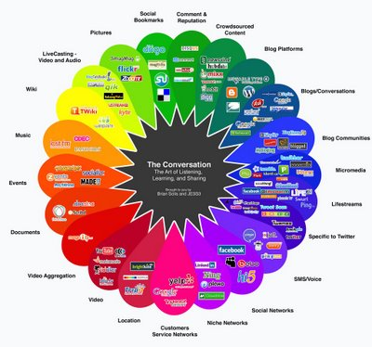
The Five Players of Advertising
The Media
Channels of communication that carry the message
Notes:
Video, web site of an agency

Slide 14
The Five Players of Advertising
The Suppliers
Provide specialized service
Artists, writers, photographers, directors, producers, consultants….

Slide 15
The Five Players of Advertising
The Target Audience
Retailers, consumers, employees, stockholders
Identification of the target audience is essential for adv.
Adv. strategy, creative strategy, media strategy
Research

Slide 16
Types of Advertising
Brand advertising
Retail advertising
Local advertising
Direct-response advertising
Business-to-business advertising
Institutional/Corporate advertising
Non-profit advertising
Public service advertising
Political advertising

Slide 17


Brand Advertising

Slide 18
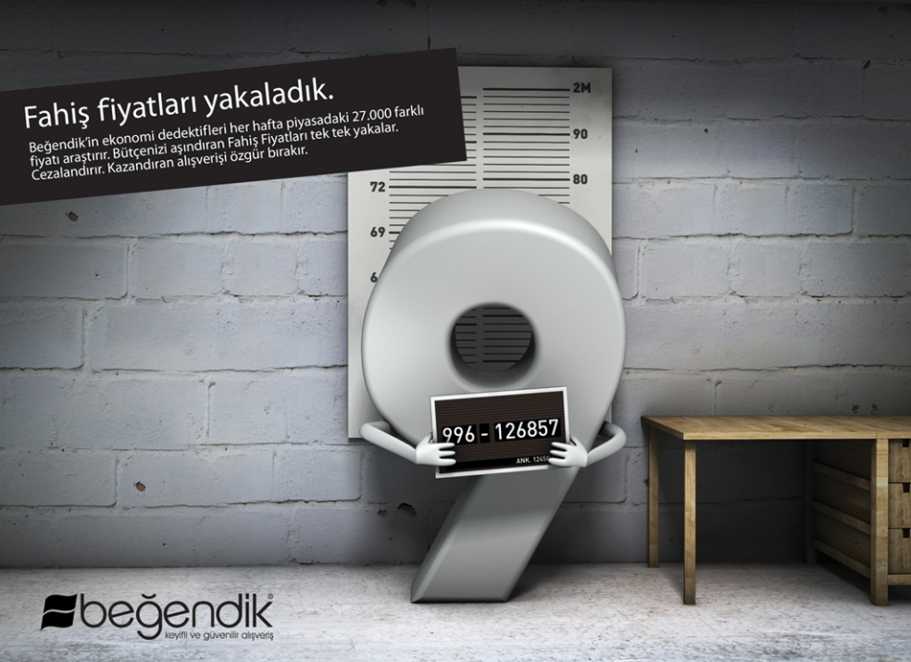
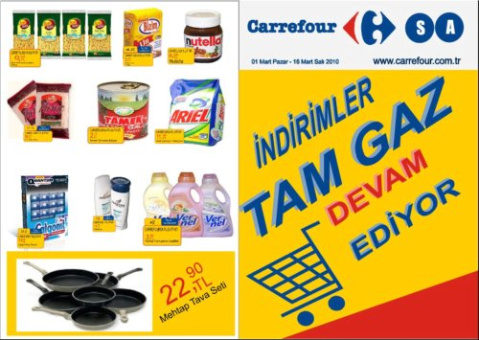

Retail Advertising

Slide 19


Local Advertising

Slide 20


Direct-Response Advertising

Slide 21
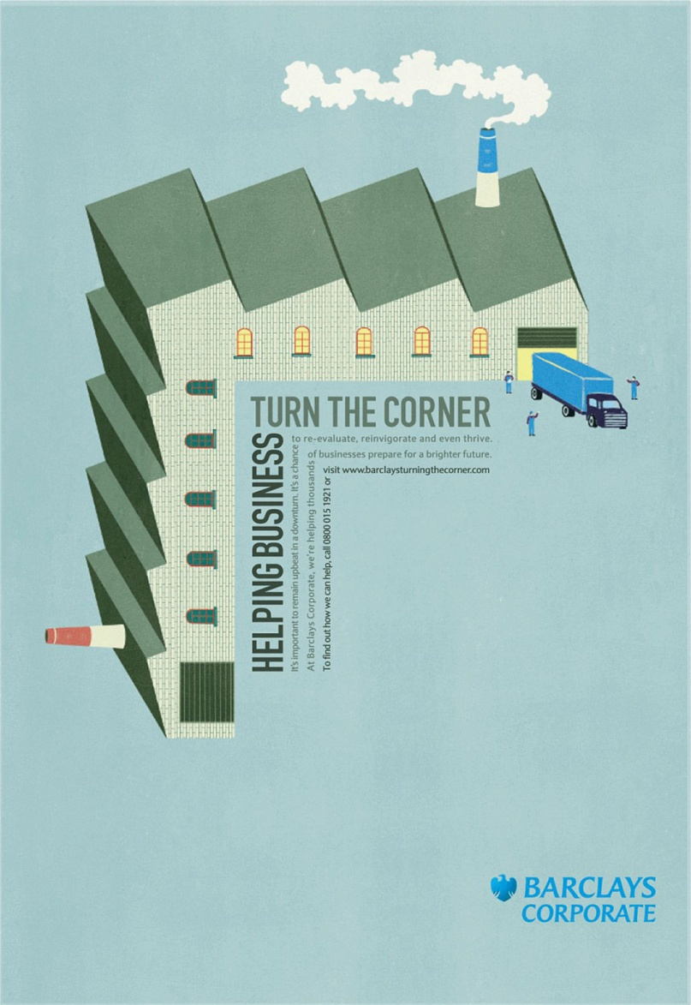

Business-to-business Advertising

Slide 22

Business-to-business Advertising

Slide 23
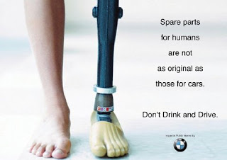

Institutional/Corporate Advertising

Slide 24
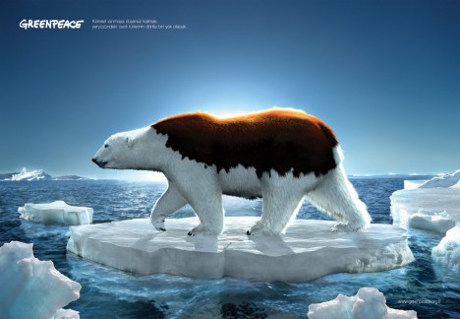

Non-Profit Advertising

Slide 25
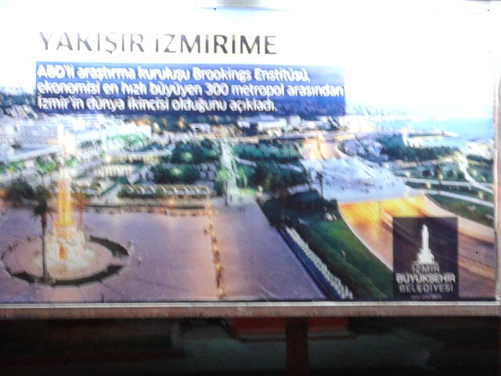
Public Service Advertising
https://www.youtube.com/watch?v=Vsvw3qOPSAE
http://www.adcouncil.org/Impact/Research/Public-Service-Advertising-that-Changed-a-Nation

Slide 26

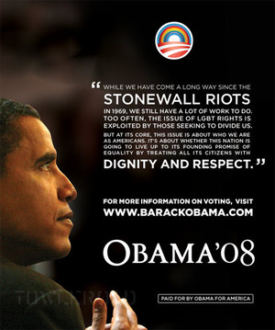
Political Advertising

Slide 27
Assignment
Find different advertisements for these types for Thursday.

Slide 28
The Evolution of Advertising
Age of print
  Classified adv. format
  Deliver information
  Newspaper
Industrial revolution and emergence of consumer society
  Social and technological developments
  More products, wide markets
  National adv.

Slide 29
The Evolution of Advertising
Modern advertising era
  Roots of today’s adv. (“reason why”, “truth in adv.”..)
Age of agencies
  Professional adv.
Creative era
  Emphasis on new creative practices (Leo Burnett, David Ogilvy, Bill Bernbach)

Slide 30
The Evolution of Advertising
Accountability era
  Research and measurement
  Advertising had to pay its own way and prove its own value
  Return-on-investment
Age of social responsibility
  Corporate citizens
  Citizen Brands
  Age of digitallization

Slide 31
The Evolution of Advertising in Turkey
Tercüman-ı Ahval in 1864: Crockery ad in Ramadan, Loton Ciznel ads about agricultural implements and iron
1957-1961: Only Resmi İlanlar Şti. has got the right to give ads.
Bank ads in radio
TRT ads in 1972
Turkish Association of Advertising Agencies in 1984

Slide 32
Current Advertising Issues
Social media advertising (SOLOMO)
Mobile advertising
Viral advertising
Interactivity
Integrated communications
Effective ads
User generated ads
Advertising awards

Slide 33
Effectiveness in Advertising
Advertisers expect specific results that lead to sales
Advertising is part art, part science
Accountability and effectivenes
Specific results that meet advertising objectives, communication impact
Measurable results
Awards
Effie advertising awards: http://www.effieturkiye.org/2009/index.htm
Effie advertising awards: http://www.effie.org

Slide 34
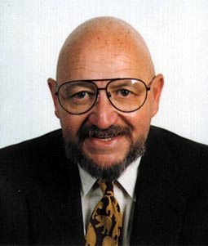
Advertising - The Business
“The greatest fun you can have with your clothes on...”
Jerry Della Femina

Slide 35
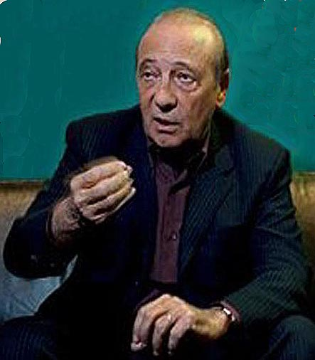
Advertising - The Business
“Don’t tell mom I’m in advertising, she thinks I’m a pianist in a brothel.”
Jacques Seguela

Slide 36
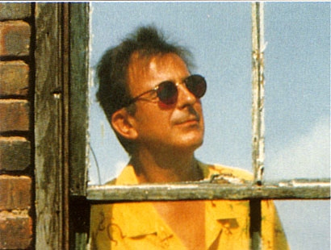
Advertising - The Business
“Roach motel : You can check in, but cannot check out !”
Ed McCabe

Slide 37
Chapter 2
Advertising’s Role in Marketing
Outline
Key concepts in marketing
The marketing mix
The marketing process and advertising
Current marketing issues
Ad agencies: combining marketing and advertising

Slide 38
Marketing
“Marketing is the way a product is designed, tested, produced, branded, packaged, priced, distributed and promoted.” (Moriarity, Mitchell and Wells, 2012: 62)
American Marketing Association (2007) defines
  “Marketing is the activity, set of institutions, and processes for creating, communicating, delivering and exchanging offerings that have value for customers, clients, partners and society”

Slide 39
Key Concepts in Marketing
Focus on stakeholders
  Identify the needs and wants of the stakeholders and develop products for solving customers’ problems
Exchange
  Product-money exchange
  Communication exchange
Added value
Differentiation and competitive advantage
Branding
  Brand image
  Status, quality, good value
  Familiar brands
  Brand equity
  Trademark

Slide 40
Best Global Brands in 2014
http://bestglobalbrands.com/2014/ranking/#?listFormat=ls
Source: www.interbrand.com

Slide 41
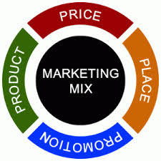
The Marketing Mix

Slide 42
The Marketing Process
Situation analysis (Research about competitors and consumers, SWOT)
Objectives
Consumer needs and wants-products, segmentation
Differentiation and positioning
Marketing mix strategy
Evaluation of the effectiveness

Slide 43
The Marketing Process and Advertising
In order to do effective advertising;
features,
distribution,
price strategy,
of the product should be well known.
You need to build upon your advertising strategy according to the elements of marketing mix.

Slide 44
Current Marketing Issues
Integrated marketing
  Consistent voice of a brand
Relationship marketing
  Identifying and creating new value with individual customers, stakeholders, employees, agencies, investors, distributors... and sharing the benefit of this.
  CRM
Permission marketing
  Interactive comm. technologies
  Inviting prospective customers to hear the messages about the brand by their own will.
Experience marketing
Guerilla marketing
  Using creative ways to reach people where they live, work, and walk
  Limited budget, short time
  Creating impact by word of mouth

Slide 45
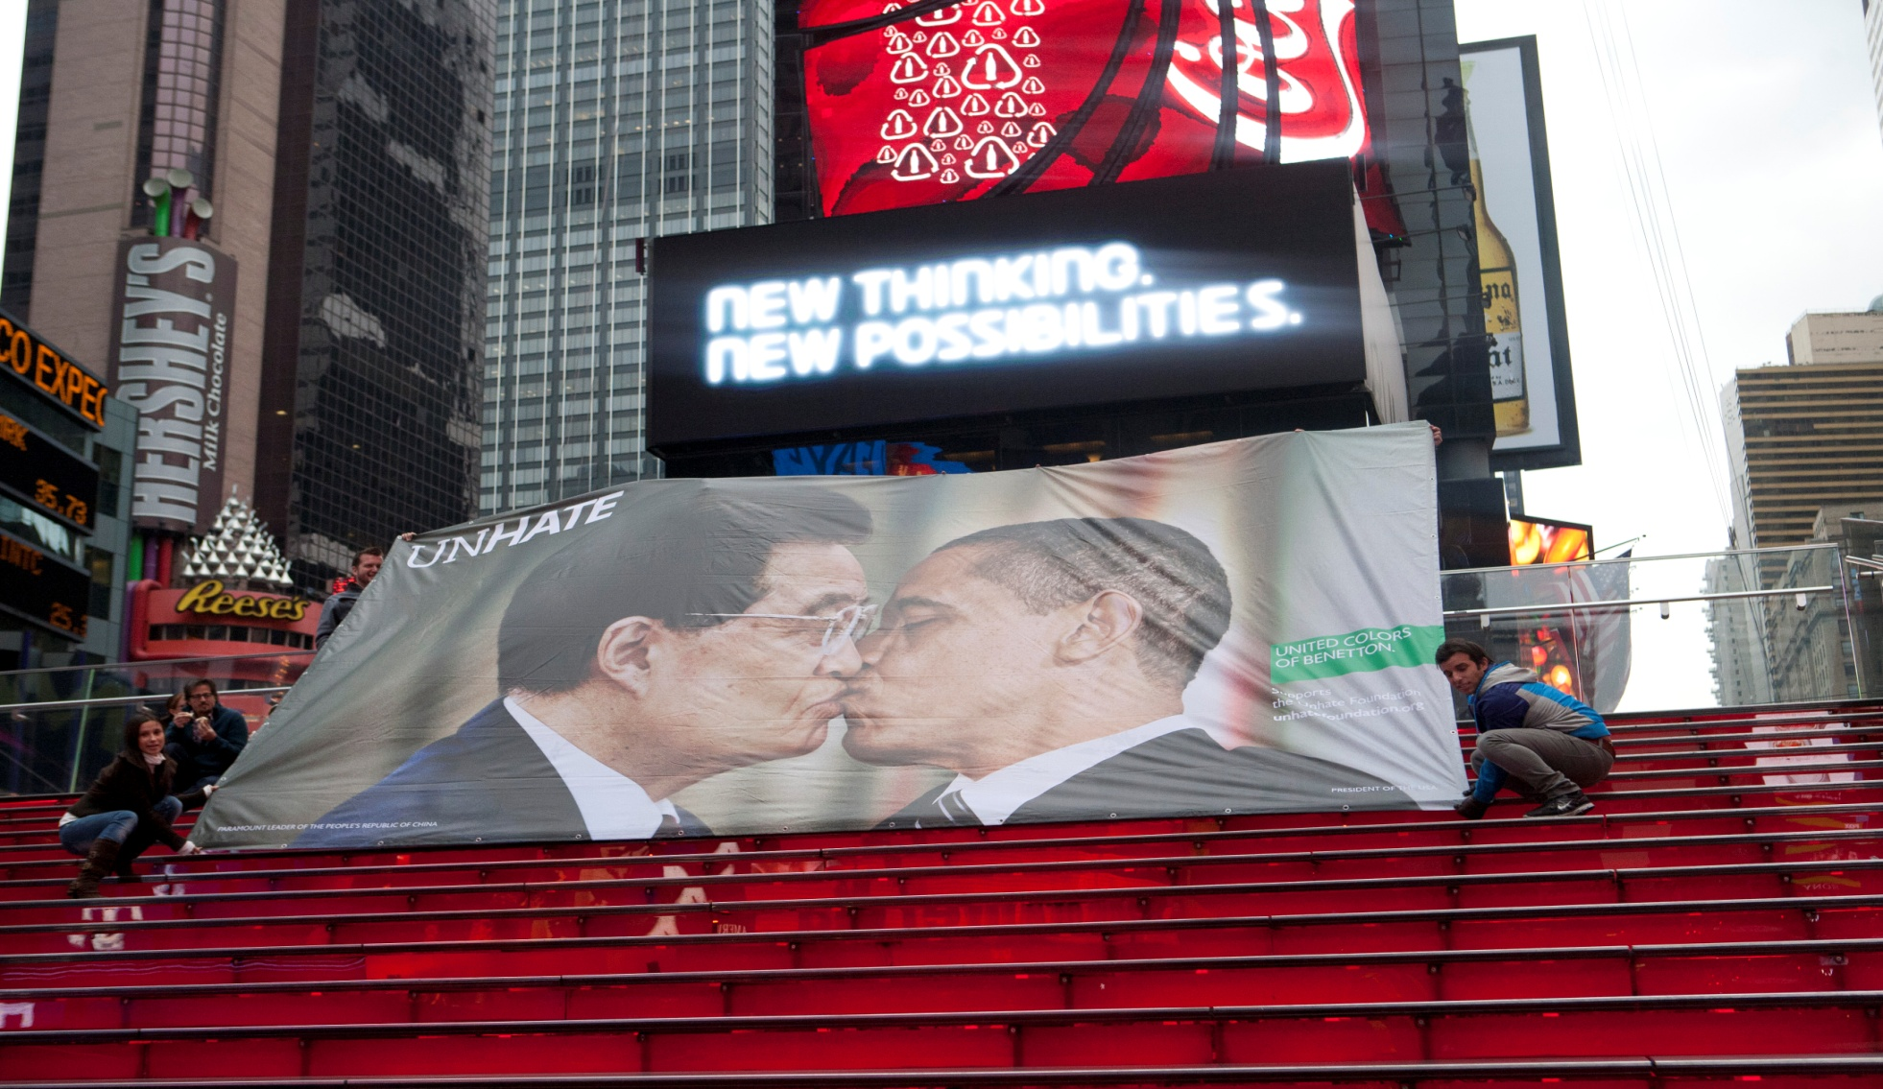
Guerilla Marketing for Benetton NewYork Unhate Campaign

Slide 46
Current Marketing Issues
Digital marketing
Viral marketing
  Technique that spreads the word about products through an online network users
Mobile marketing
Social network marketing
Engagement marketing
Neuro marketing
WOMM
Notes:
Advance Digital and Cross-Platform Measurement , Ensure Integration Across Expanding Media Platforms, Optimize the Agency-Client Relationship , Develop 21st-Century Marketing Skills , Focus on Sustainability, Right-Time Multichannel Marketing, Customer Intelligence...

Slide 47
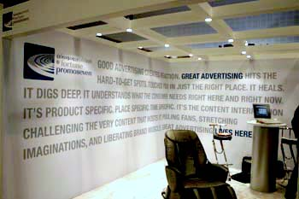
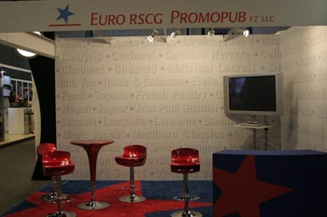
Ad Agencies
Why hire an ad agency?
Why not hire an agency?

Slide 48
Working with an external agency or an in-house agency?
Size of the account
Amount of the money that can be spent for media
Objectivity
Complexity of the product
Creativity

Slide 49
Ad Agencies
Types of agencies
  Full-service agencies
  Specialized agencies
  Creative boutiques
  Media planning and buying agencies
  Digital agencies
Notes:
Full service agencies: Advice about how to develop target markets, suggestions on how to project a strong company image and theme, assistance in selecting company logos and slogans...

Slide 50
Ad Agencies
How agencies are organized
  Account management
  Strategy planning and research
  Creative development and production
  Media planning and buying
  Internal services

Slide 51

Ad Agencies
How agencies are paid
  Commission (Media, Client)
  Fee
  Hourly rate

Slide 52
Top 5 Agencies of Turkey in 2014
Güzel Sanatlar Saatchi&Saatchi
Y&R İstanbul
TBWA İstanbul
Lowe İstanbul
Publicis Türkiye
Source. http://www.mediacatonline.com/ilk-6-ayin-en-buyuk-reklam-ajanslari/
Notes:
Source: http://www.mediacatonline.com/ilk-6-ayin-en-buyuk-reklam-ajanslari/ (Mediacat, 2014)

