Slide 1
CHAPTER 5
THE CONSUMER AUDIENCE
Cultural and social influences
Psychological influences
Behavioral influences
Segmenting and targeting

Slide 2
How Does Consumer Behavior Work?
Consumer behavior
  Describes how individuals or groups select, purchase, use, or dispose of products – as well as describing the needs that motivate these behaviors
Consumer audience
  People who buy or use products to satisfy their needs and wants
Customers
  People who buy a particular brand or patronize a specific store

Slide 3
Consumer Audience
In order to understand our consumers, we should identify cultural, social, psychological and behavioral influences which affect consumer audience’s behavior.

Slide 4
Cultural and Social Influences
Culture
Tangible items (furniture, clothing, buildings…) and intangible concepts (laws, morals, customs…) that together define a group of people or a way of life
Social Class
The position a person and his/her family hold within society
Income, wealth, education, occupation, family prestige, value of home, and neighborhood are the main factors that determine social class

Slide 5
SES Groups in Turkey

Slide 6
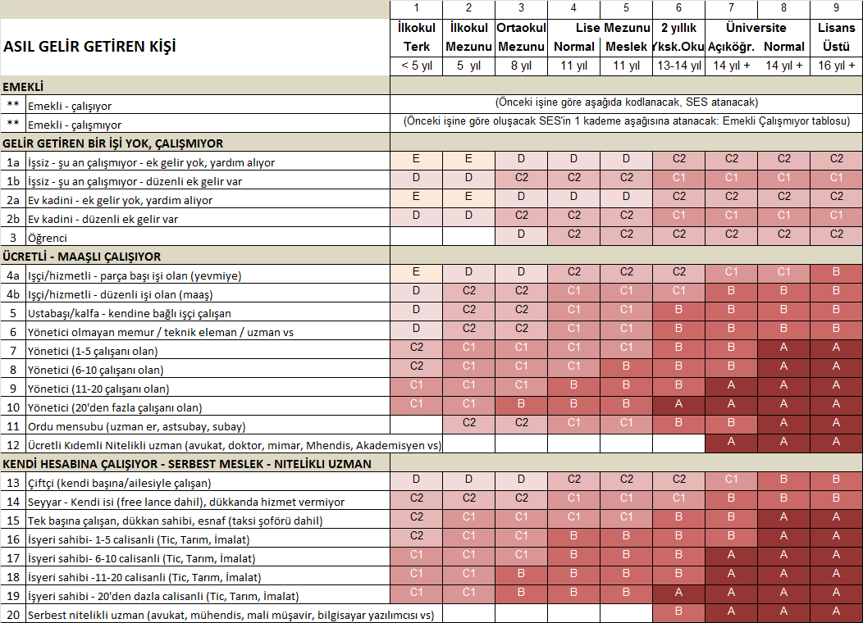

Slide 7
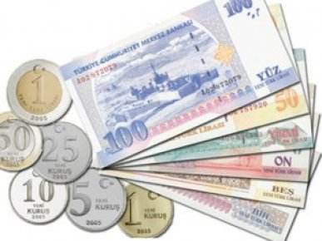


2012 Household Socioeconomic Status
Meslek
Occupation
Meslek
?
+
Eğitim
Education
AGG’nin
EŞİ
SPOUSE OF THE HOUSEHOLDER
ASIL GELİRİ
GETİREN KİŞİ
HOUSEHOLDER
(THE PERSON WHO EARNS
THE MONEY IN THE HOUSE)

Slide 8
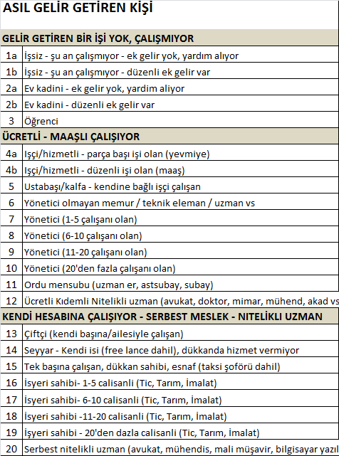
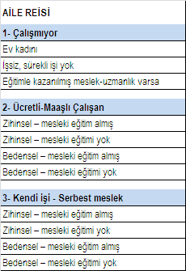
Meslek Boyutunda:
Bedensel / Zihinsel ve Eğitimli / Eğitimsiz tanımlaması yerine “daha anlaşılır” meslek gruplamalarına gidildi ve gelirle orantılı ölçeklere oturtuldu.
2012 SES OLUŞUMU
Notes:
8

Slide 9
2012 SES Dağılımı
ABC1 | Total | A | B | C1 | C2 | D | E
34% | Base | 4% | 9% | 22% | 29% | 28% | 9%
39% | KENT | 5% | 10% | 24% | 31% | 22% | 8%
14% | KIR | 1% | 2% | 11% | 22% | 52% | 12%
Baz: 5000 örneklemli Türkiye geneli saha çalışması – ağırlıklandırılmış olarak.

Slide 10
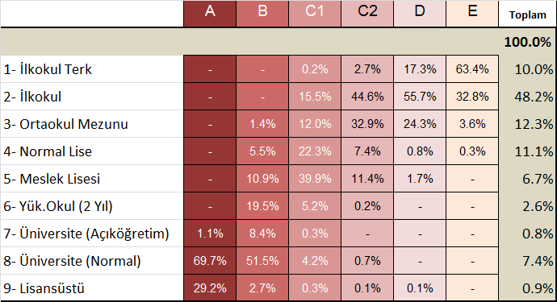

AGG, Eşi - Eğitim & Çalışma Durumu
AGG Eşi
Eğitim
AGG - Asıl Geliri Getiren Kişi
%82
AGG Eşi – Çalışma oranı
Tüad www.tuad.org.tr

Slide 11
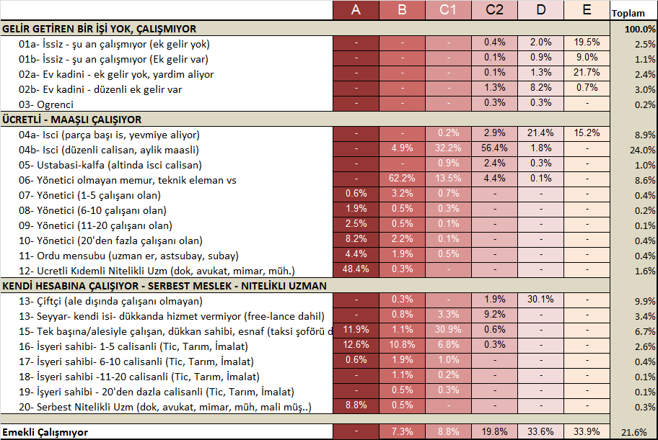
AGG - Meslek Dağılımı...
AGG - Asıl Geliri Getiren Kişi
Tüad www.tuad.org.tr

Slide 12
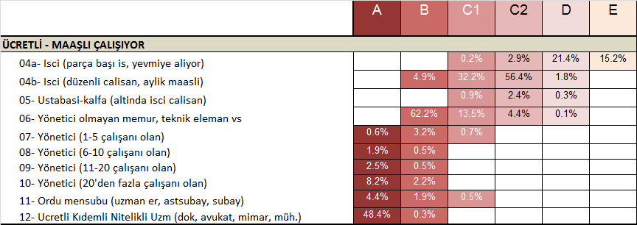

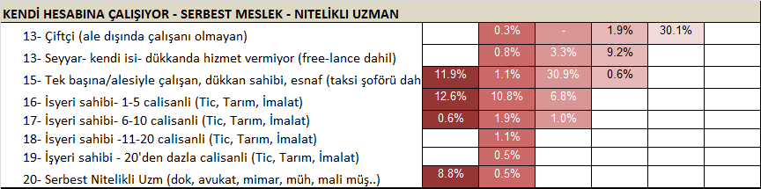


MESLEK ODAKLILIK- Gelir endeksi...
Tüad www.tuad.org.tr

Slide 13
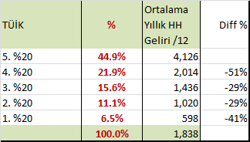
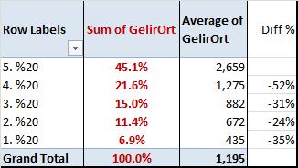
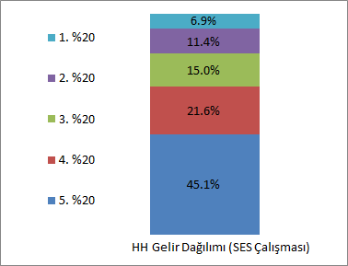
Gelir Dağılımı
Kaynak: TÜİK, Hane Gelir Dağılımı
Kaynak: TR geneli SES çalışması (n=5000)
Tüad www.tuad.org.tr

Slide 14
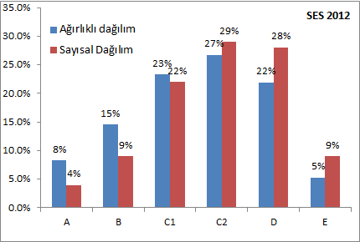
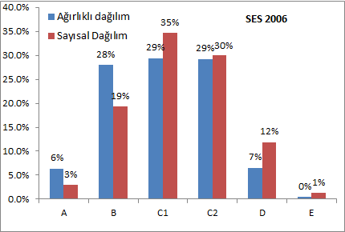
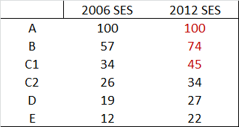
ÜST ORTA SINIF ← → ALT ORTA SINIF ....
Ortalama gelir Endeksi (A=100) →
Not: 2006 SES ve 2012 SES örtüşme oranı %75’dir.
Tüad www.tuad.org.tr

Slide 15
SONSÖZ: 2012 SES’in getirdikleri….
Meslek odaklılık
  Meslek gruplaması günlük hayatta karşılığı daha net bulunur ve gelirle ilişkisi daha net anlaşılır hale getirilmiştir;
  SES atamasında mesleğin eğitimden daha ağırlıklı rol oynaması sağlanmıştır; bu da ekonomik faktörün entegrasyonuna katkı sağlamıştır.
Dinamik yapı
    Kişilerin kariyer ve ekonomik gelişimlerine paralel olarak farklı SES gruplarında bulunabilmesine olanak sağlayan bir tanımlama getirilmiştir.
Daha kristalize bir gruplama
    Özellikle alt ve üst SES grupları içinde önemli bir ayıraç teşkil eden C1’in C2’den farklılaştırılması sonucu, gruplar arası ayrıştırma daha net bir çizgiye oturtulmuştur.
Uygulamada pratiklik
    Saha uygulamasında pratik, daha anlaşılır, dolayısıyla zaman avantajı getiren bir yaklaşım getirilmiştir.
Sektörde ortak dil oluşturma
  Süreç olarak çok katılımlı, yaygın iletişimli, araştırma kullanıcılarının ve uygulayıcıların geri bildirimlerine açık bir yaklaşım izlenmiş, bu da ortak dil oluşması için uygun zemin yaratmıştır.

Slide 16

APPENDIX
Peki
kim bu A, B, C..ler?

Slide 17

A SES Group
Almost all of them are university graduates, 30% are post-graduates...
Half of them are working as qualified speacilists, i.e. lawyers, doctors, engineers… with monthly salaries
Approximately 10% are white collars who have more than 20 employees; ¼ have small or medium enterprises (app. half of them do not have employees.)
40% of the householders’ spouses are working.
20% of the houses are saving money.
30 % are spending their holidays by at the hotels.
Almost half of the houses have bookcases/libraries

Slide 18

B SES Group
60% of them are university graduates or post-graduates. 35% are vocational school graduates or high school graduates.
60% are working as officers, technical staff or specialists who are not managers.
15% have small or medium enterprises which have 1-5 employees.
30% of the householders’ spouses are working.
13% of the houses are saving money.
20% are spending their holidays by at the hotels.
30% of the houses have bookcases/libraries.

Slide 19
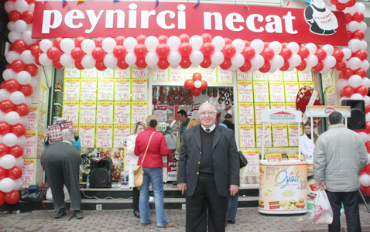
C1 SES Group
60% are high school graduates (20% are vocational school); 10% are university graduates or higher.
40% are shopkeepers, own shops; 30% are qualified workers who are high school graduates.
Approximately 15% are working as officers or technical staff.
Approximately 15% are retired.
13% of the householders’ spouses are working.
5% of the houses are saving money.
20% are spending their holidays at the hotels, 40% spend their holidays by visiting their relatives.
Approximately 20% of the houses have bookcases/libraries.

Slide 20
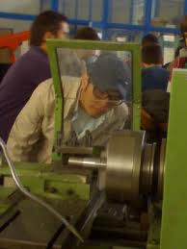
C2 SES Group
App. 20% are high school graduates, secondary and primary school graduates are 80%.
Most of them are primary school graduates who are regular workers (%60).
10% are working as individual costermongers or barrowmen.
20% are retired, they are not working.
The rate of working householders’ spouses is 10%.
70% do not go on holidays, 25% visit their families or relatives.
10% of the houses have bookcases/libraries.

Slide 21
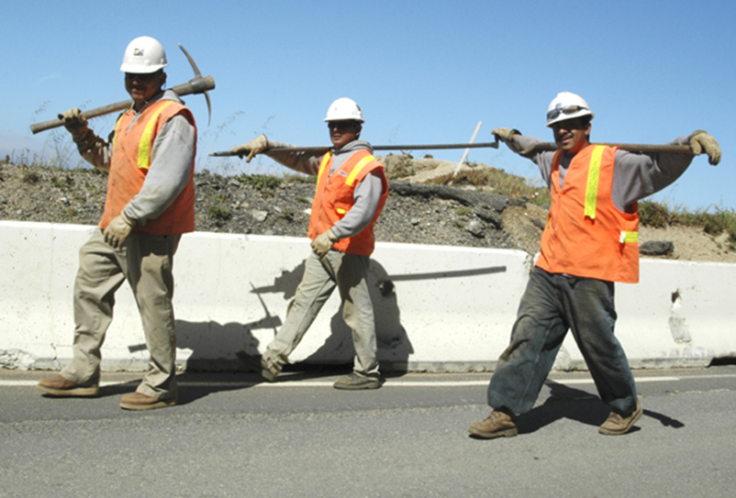
D SES Group
• The rate of primary school graduates and primary school drop-outs is above 70%. The rest are secondary school graduates.
• 30% are retired, they are not working.
• 20% are working as laborers (they are not affiliated to any factory or company)
• 30% are small-sized farmers.
• 10% are housewives.
• 80% do not go on a holiday, the rest are going to their hometowns.

Slide 22
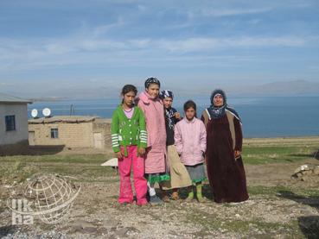
E SES Group
95% primary school graduates or primary school drop-outs.
30% are unemployed. (Most of them are depending on help to survive)
40% are retired, not working; 30% are retired adn working as laborers
The other 20% of the houses’ householders are housewives who do not have a mothly salary and depend on help.

Slide 23
BİRAZ DAHA YAKINDAN TANIYALIM...

Slide 24
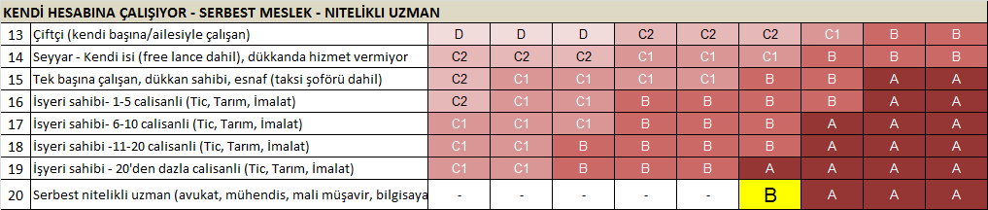
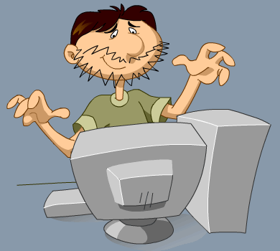

Yazılımcı Berk
Kaptan Necati
Selçuk Üniversitesi
Bozkır Meslek Yüksekokulu- Bilgisayar Programcılığı
9 Eylül Üniversitesi
Deniz İşletmeciliği ve Yönetimi Yüksekokulu

Slide 25
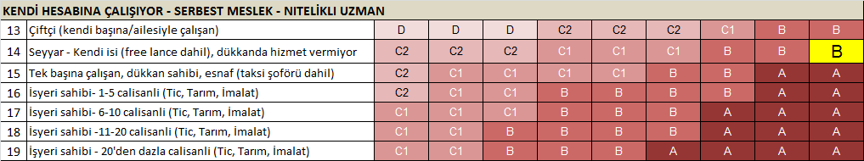

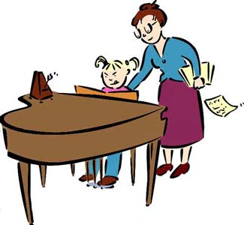
İngilizce Çevirmen Ali
Piyano öğretmeni Nilgün
İstanbul Üniversitesi
İngiliz Edebiyat Phd
Juliard
Piano Degree

Slide 26
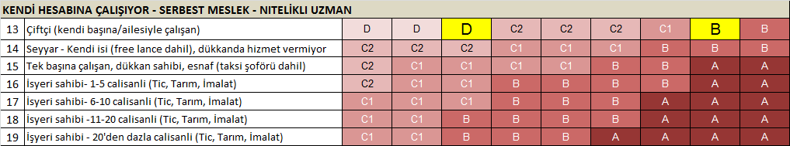

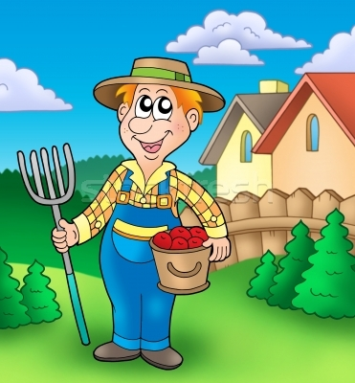
Çiftçi, traktör kullanıcısı Hüsnü
Organik tarım yapan çiftçi Burak
Ulukışla Ortaokulu
İstanbul Üniversitesi, Mühendislik Fakültesi
Ziraat Mühendisi

Slide 27
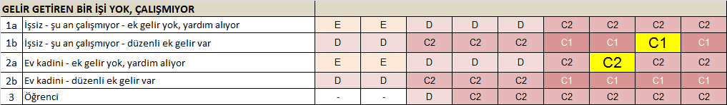
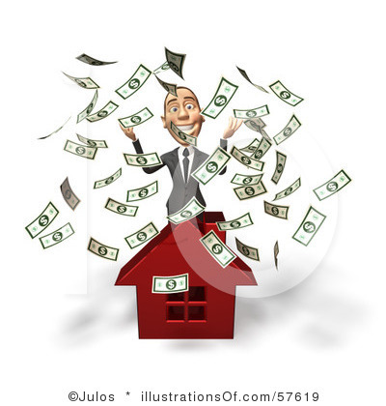
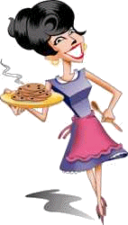
Ev hanımı Sibel
Nafaka ile geçiniyor
İrad sahibi Mehmet
Açık Öğretim
İstanbul Üniversitesi,İktisat Fakültesi
Ekonometri

Slide 28
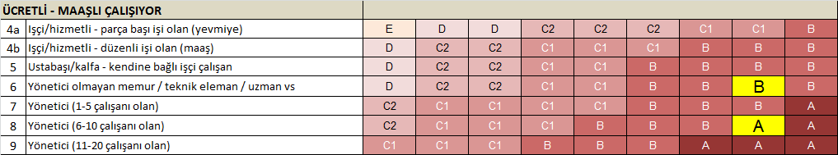
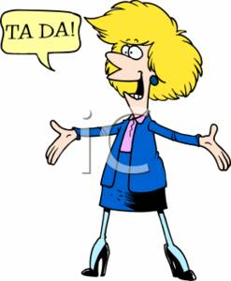

6 yıl ve 2 çocuk
sonra... ☺
Müşteri Temsilcisi Nazlı
Müşteri Grup Müdürü Nazlı
Ortadoğu Teknik Üniversitesi
İşletme Fakültesi
Ortadoğu Teknik Üniversitesi
İşletme Fakültesi

Slide 29
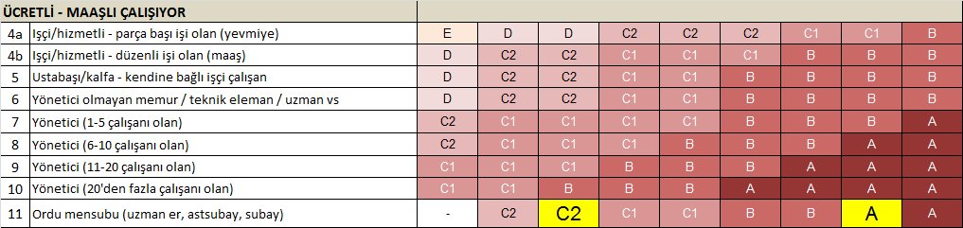
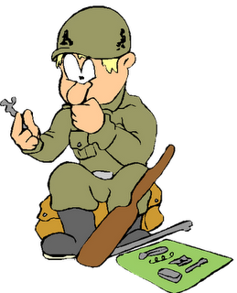
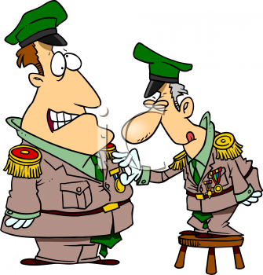
Uzman Çavuş Mehmet
Albay Osman
Ortaokul Mezunu
Harp Akademileri Mezunu

Slide 30
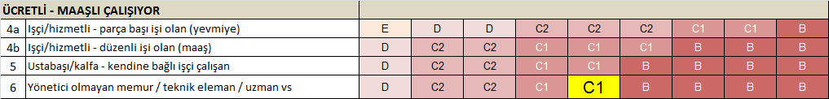


Serbest Mali Müşavir Murat
Muhasebeci Atilla
Yıldız Teknik Ünivesitesi
İktisadi ve Ticari İlimler Fakültesi
İktisat Bölümü
Rize Ticaret Meslek Lisesi

Slide 31


Başkasının taksisinde şöförlük yapan Selami
Kendi arabasında taksi şöförü Arif
Kastamonu Merkez Ortaokulu
Sarıyer Lisesi

Slide 32
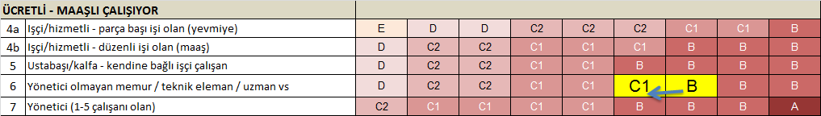

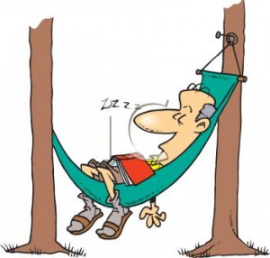
Emekli memur Hulki
Çalışıyor
Emekli memur Ahmet
Çalışmıyor
Eskişehir Anadolu Üniversitesi
Açık Öğretim
Eskişehir Anadolu Ünivesritesi
Açık Öğretim

Slide 33
Cultural and Social Influences
Reference Groups
A group of people who are used as a guide for behavior in specific situations
Family
Two or more people who are related by blood, marriage, or adoption and live in the same household

Slide 34
Cultural and Social Influences
Demographics
The statistical, personal, social, and economic characteristics that describe a population
Characteristics
Age
Gender
Sexual orientation
Race and ethnicity
Education
Occupation
Income
Geography

Slide 35
Psychological Influences
Perception/State of Mind
Past experiences with a brand
Mental states
affect perception of consumers
Needs and Wants
Self-actualization
Ego Needs
Belonginess
Safety
Phsiological
Moslow’s Hierarchy

Slide 36
Psychological Influences
Motivations
Incentive to take an action
Internal forces that stimulate people to behave in a particular manner
Produced by the tension caused by an unfulfilled need

Slide 37
Psychological Influences
Attitudes and Values
Attitudes impact motivations
Influence how consumers evaluate products, institutions, retail stores, and advertising
Personality
Distinctive characteristics that make people or brands individual
Brand personalities make them distinctive from their competitors

Slide 38
Psychological Influences
Psychographics
Lifestyles
  Looks at the ways people allocate time, energy, and money
The VALS system
  Lifestyle profiles that collectively reflect a whole culture
Trends
Psychographic Influences
Lifestyle and psychological characteristics that have a bearing on how people make decisions

Slide 39
Behavioral Influences
Usage behavior
  How much of a product category or brand customers buy
Innovation and adoption
  How willing people are to be innovative and try something new
  Innovators, early adopters, early majority, late majority, laggards

Slide 40
Segmenting and Targeting
Segmenting
  Dividing the market into groups of people who have similar characteristics in certain key product-related areas
Targeting
  Identifying the group that might be the most profitable audience

Slide 41
Segmenting and Targeting
Types of segmentation
  Demographic
  Life stage
  Geographic
  Psychographic
  Behavioral
  Benefits

Slide 42
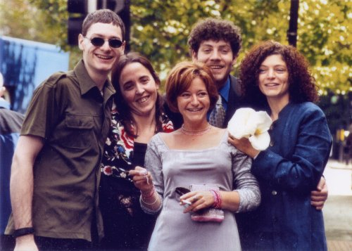
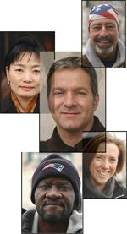
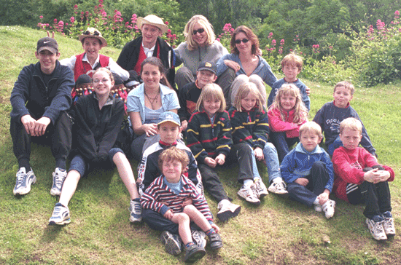
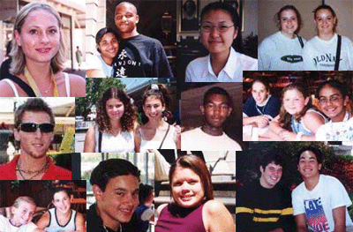
Segmenting and Targeting
Sociodemographic segments
  Segmenting according to the year born:
Generation X
(1965-1979)
The Millenium Generation (2000- )
Baby boomers
(1939-1964)
Generation Y
(1980-1999)

Slide 43
Segmenting and Targeting
Niche markets
  Group of people defined by some distinctive trait
    Antique collectors
    Pregnant women
    New mothers...

Slide 44
Segmenting and Targeting
Targeting the right audience
  The target is described using the variables that separate this prospective consumer group from others who are not in the market
Profiling the target audience
  Describing the target audience as if they are people you know
  Used in developing media and message decisions

Slide 45
Target Audience Profile
TecWare Teens:
  Are girls and boys ages 14 – 17
  Come from households with incomes $100,000+
  Are interested in technology, the Internet
  Frequent chat rooms, use email daily, and play computer video games
  May hold a part-time job or volunteer as a web-master, computer teacher or similar high-tech entry level position
  Have allowances of $20 a week in addition to their jobs
  Whose parents purchase at least $500 in “back to school” clothing

Slide 46

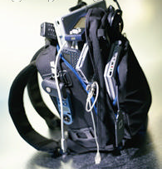
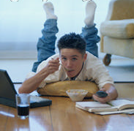

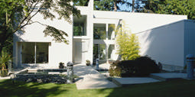
Target Audience Profile contd.
  Alexis and Ryan
  Alexis, 16, and Ryan, 14, are brother and sister. They live in the city’s best neighborhood, in a three-story modern home from the pages of Architectural Digest. In their free time, they volunteer to maintain web sites for the family’s church, the local fire department and their high school. There is one television but 3 computers in the home – Dad’s laptop for work, the “family computer” and Ryan’s personal computer that he bought with money earned teaching senior citizens computer skills. Dad is Vice President of eCommerce for a national bank and Mom is a reporter for the online version of the city’s newspaper.

Slide 47
Useful Questions for Defining the Target Audience
1. Who is your target audience?
2. Where is your target audience located?
3. What is the age range and median age?
4. Is the group primarily male or female?
5. What do they do for a living?
6. What level of education do they have?
7. How do they spend their extra cash?
8. Are they married, single, or divorced?
9. Do they have children? What ages?
10. What kind of lifestyle do they lead?
11. What are their attitudes and beliefs?
12. Are they urban dwellers or suburbanites?
13. What are their special interests or hobbies?
14. What is their income range?

Slide 48

Target Audience?

Slide 49
Target Audience?
Axe commercial: http://www.youtube.com/watch?v=IeNNFoIMhQU

Slide 50
Weekly Assignment
(Individual Assignment)
Define and profile the target audience of mesir paste according to the cultural, social, psychographic, demographic and behavoural influences in details. Write a one page report about the results of your research individually.
Deadline: 16th April Thursday, class time.
Please do not forget to sign while you are handing in.

