Slide 1
Chapter 3
Advertising and Society
Advertising’s social role
Advertising’s regulatory environment
Advertising ethics
Determining “ethical” and “not ethical”

Slide 2
Advertising’s Social Role
Shaping or mirroring society
“Adv’g makes people who can’t afford it buy things they don’t want with money they haven’t got.”- Joan Blandings 1948
“Adv’g is legalized lying.”- H.G.Wells (1866-1946)
“Adv’g is the cheapest way of selling goods, particularly if the goods are worthless .” Sinclair Lewis (1885 – 1951)
“Advertising’s contribution to humanity is exactly minus zero.” F. Scott Fitzgerald 1896 - 1940

Slide 3
Advertising’s Social Role
“Adv’g has been blamed for rising of
eating disorders, eruption of violence in
streets, our epidemic of depression,
despoiling of cultural icons, corruption of
politics, carnavalization of holy times
like Xmas, and gnatlike attention span of
youth. All this is true. Adv’g contributes.
(…) But adv’g is more a mirror than a
lamp.”
James B. Twitchell

Slide 4


L'internationale publicitaire
Armand Mattelart
99 Franc
Frederic Beigbeder

Slide 5
Advertising’s Regulatory Environment
Federal Trade Commission
  Primary commission governing adv. industry in USA
  Focus advertising, eliminate ads those are deceptive and misleading
Media review of advertising
Self regulation
  Self-discipline
  Industry self-regulation
  Self-regulation with outside help
Notes:
Self discipline: Organization’s norms

Slide 6

Advertising Ethics
Poor taste and offensive advertising

Slide 7

Advertising Ethics
Poor taste and offensive advertising

Slide 8
Advertising Ethics
Stereotyping in advertising: A stereotype is a representation of a cultural group that emphasizes a trait or group of traits that may or may not communicate an accurate representation of group.
  Women in advertisements
  Racial and ethnic stereotypes
  Senior citizens
  Gay and lesbian consumers

Slide 9
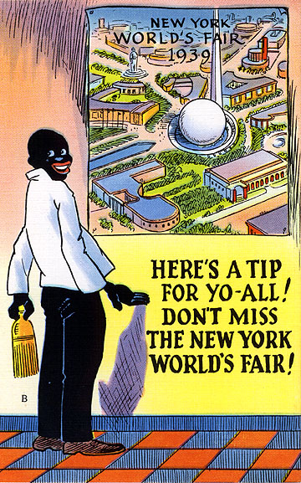
Stereotyping

Slide 10



Slide 11

Stereotyping
In this ad, we see a woman who is not organized about moving and looks as though she does not know what to do next. If she uses this marker, she will have a better handle on things. Her marker is the only thing in the world that would allow her to be more organized about things, instead of having someone else around to help her out.

Slide 12
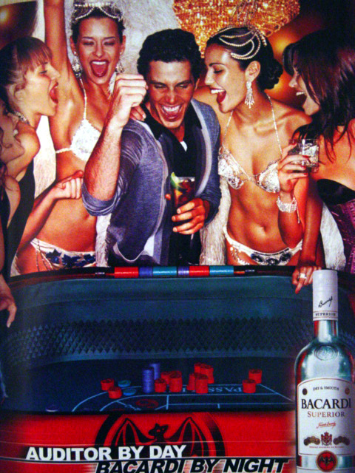
Advertising Ethics
Body Image and Self Image

Slide 13
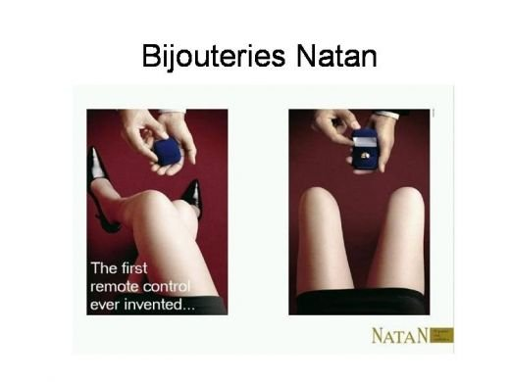
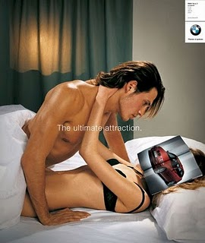
Sexuality and Gender
Notes:
Natan Bijoux and BMW

Slide 14
Advertising Ethics
Advertising to/with children
Misleading claims
Puffery
Comparative
Endorsement
Demonstration

Slide 15

Child Abuse/ BMW

Slide 16

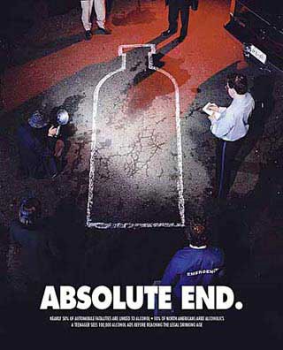
Misleading claims
Notes:
No drink campaign

Slide 17

Puffery Advertising
Notes:
Before/After ads

Slide 18
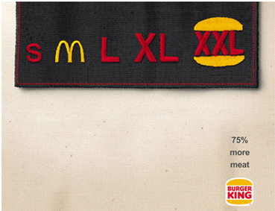
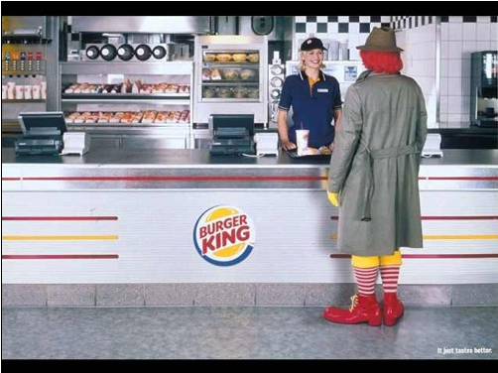
Comparative advertising
Notes:
Burger King vs Mc Donald’s

Slide 19
Advertising Ethics
Advertising controversial products
  Unhealthy or dangerous products
  Tobacco
  Alcohol
  Prescription drugs

Slide 20
Advertising Ethics
The Subliminal Issue: Subliminal effects are message cues given below the threshold of perception
Critics claim that advertising can manipulate people subconsciously and cause them to buy things they don’t want or need

Slide 21
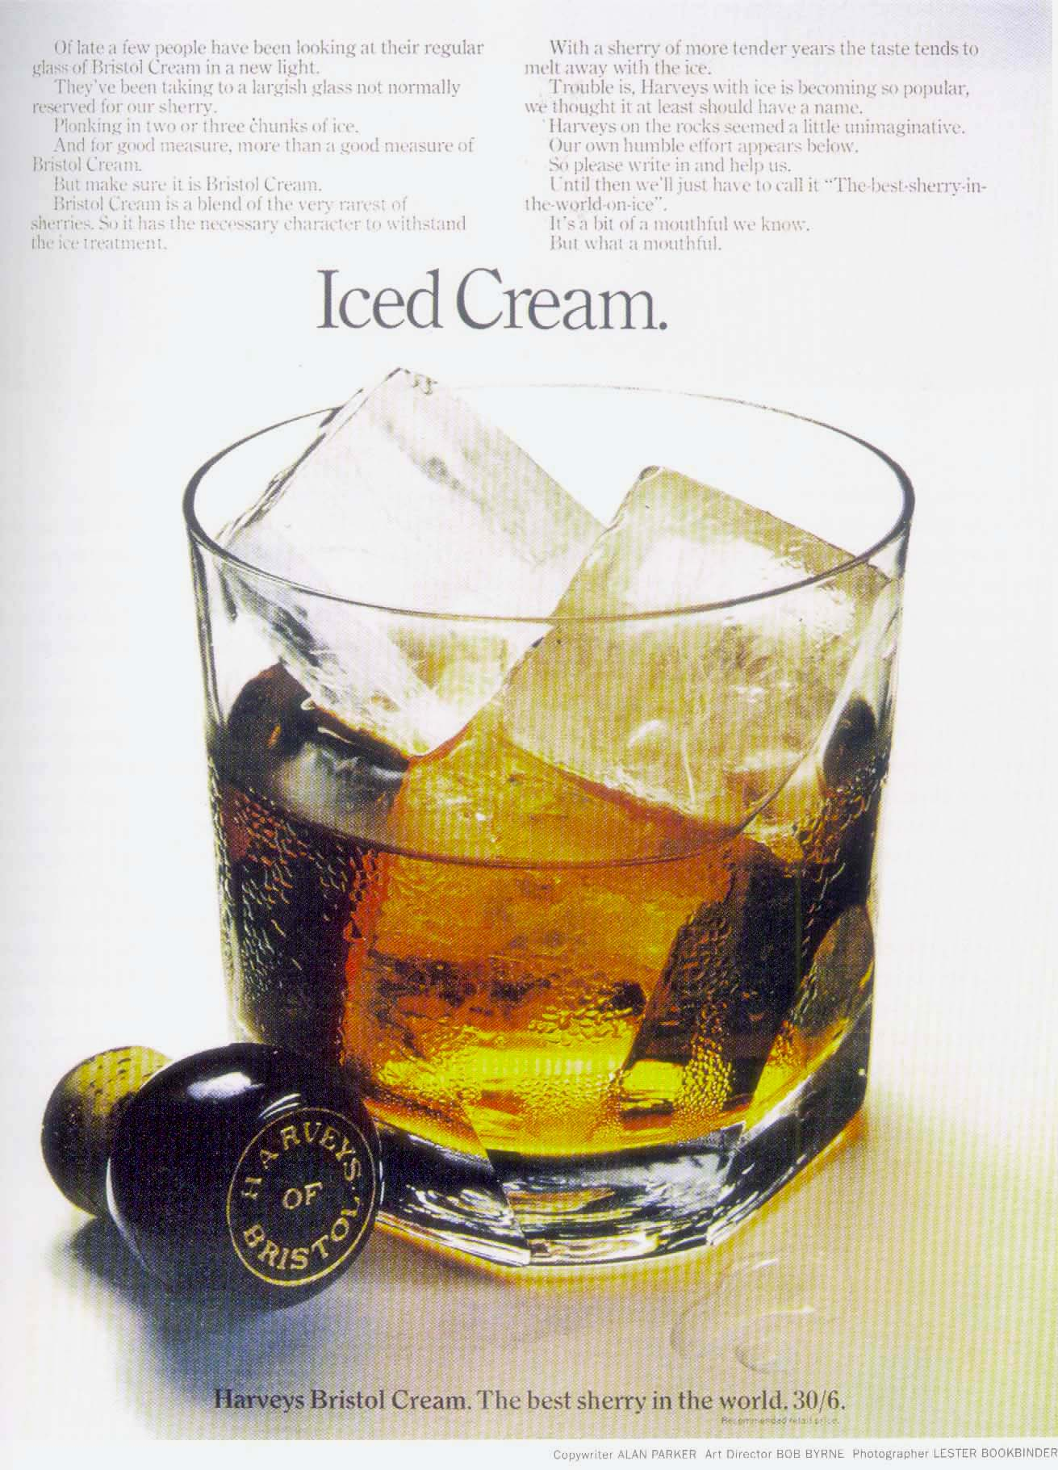
The Subliminal Issue

Slide 22
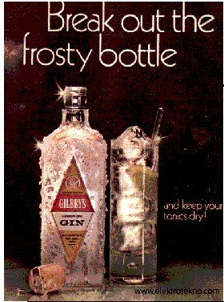
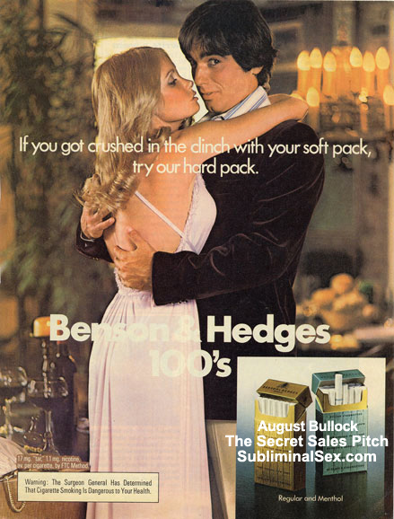
More About Subliminal Issue

Slide 23

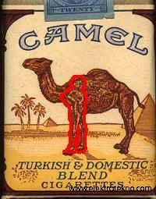
More About Subliminal Issue

Slide 24
Determining “Ethical”
The social ethic - “do no harm”
The professional ethic – “objective panel of professional colleagues”
The personal ethic – “would I feel comfortable?”

Slide 25
What is not ethical?
False or misleading statements or exagerations
Testimonials that do not reflect the real opinion of the individuals
Price claims that are misleading
Claims insufficiently supported
Offensive statements, suggestions, or pictures

Slide 26
Chapter 4
Advertising in Communication Process and Advertising Models
Basic Comm. Model
Advertising Comm. Model
How advertising creates consumer responses?
Advertising Models
Advertising Theory

Slide 27
Advertising and Communication
Basic Communication Model
Noise
Noise
Source/Sender
The Advertiser
Source/Sender
The Advertiser
Coded Message
The Agency
Coded Message
The Agency
Channel
Media
Channel
Media
Decoded Message
Interpretation
Decoded Message
Interpretation
Receiver
Target Audience
Feedback

Slide 28
Advertising and Communication
Advertising Communication Model
Noise: External
Public opinion
Marketing strategy
Competition...
Source/Sender
The Advertiser
(objectives)
Coded Message
The Agency
(encoding)
Channel
Media
(media mix)
Receiver
Consumer reception and
Response
Perceive, understand,
feel, connect, believe,act
Noise: Internal
Perceived needs
Information processing
Attitudes, opinions...
Feedback

Slide 29
How advertising creates consumer responses?
Perception (see/hear)
Exposure
Selection, Attention
Interest, Relevance
Awareness
Recognition
Cognition
(think)
Needs
Information
Cognitive Learning
Differentation
Recall
Emotional
Response (feel)
Wants
Liking
Emotions
Resonance
Persuasion (believe)
Attitudes
Argument
Motivation
Convinction
Loyalty
Involvement
Association (connect)
Symbolism
Conditional Learning
Brand image and
personality
Behavior (act)
Try, buy,
repeat buy,
Call, visit, click…
Prevent
Notes:
Engagement: Interaction, gamification…

Slide 30
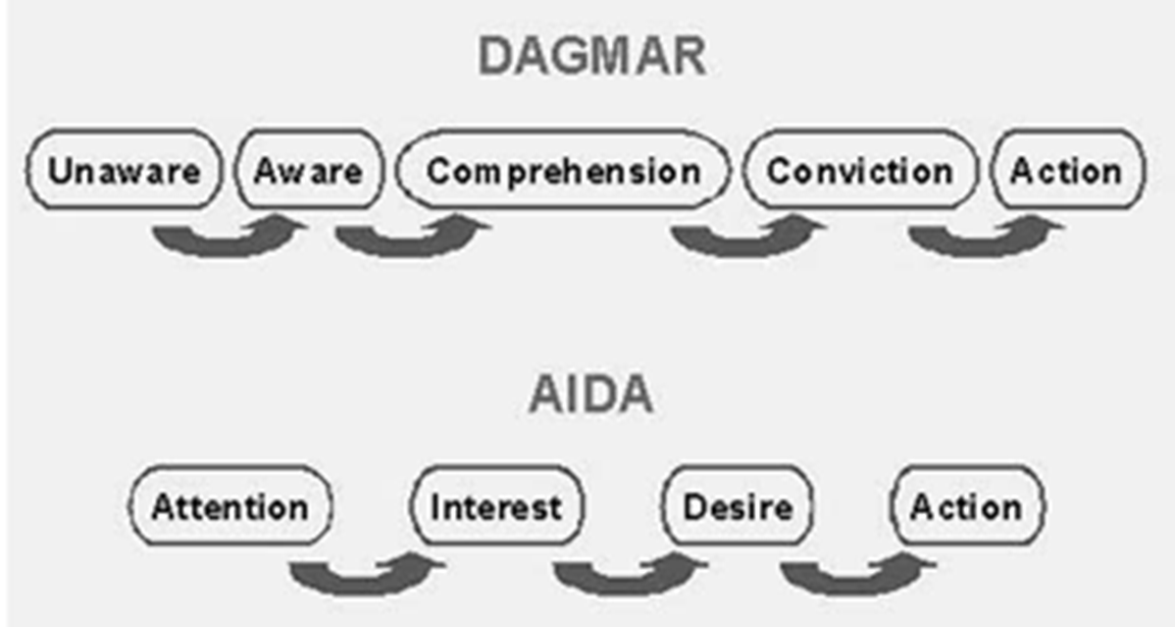
Advertising Models
AIDA Model
Think-feel-do model
NAIDAS
DAGMAR model
Notes:
Think-feel-do model: exposure to ads causes changes in cognition, emotions and behaviour.

Slide 31
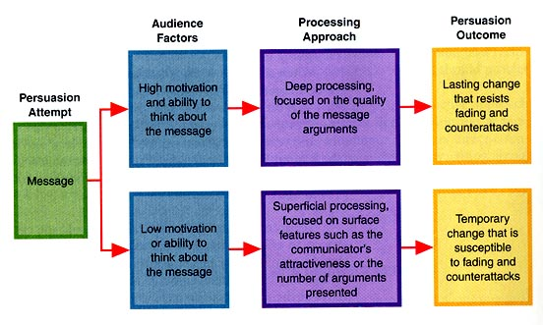
Elaboration Likelihood Model
Notes:
Elaboration Likelihood Model
Richard E. Petty and John Cacioppo in 1980s.
There are two ways we make decisions and hence get persuaded:
When we are motivated and able to pay attention, we take a logical, conscious thinking, central route to decision-making. This can lead to permanent change in our attitude as we adopt and elaborate upon the speaker’s arguments.
In other cases, we take the peripheral route. Here we do not pay attention to persuasive arguments but are swayed instead by surface characteristics such as whether we like the speaker. In this case although we do change, it is only temporary (although it is to a state where we may be susceptible to further change).
One of the best ways motivating people to take the central route is to make the message personally relevant to them. Fear can also be effective in making them pay attention, but only if it is moderate and a solution is also offered. Strong fear will just lead to fight-or-flight reactions.
The central route leads to consideration of both arguments for and against and a choice is carefully considered.
People are more motivated to use the central route when the issue has personal relevance to them. Some people have a higher need for cognition, deliberately thinking about more things than people with a lower need. These people with a higher need for cognition are more likely to choose the central route.
When they are feeling good, they will want to sustain this and will avoid focusing on things that might bring them down again, so they take a more cursory, peripheral route. People in a negative or neutral mood are more likely to take the central route.
In practice, this is more of a spectrum than a bipolar model. We may increasingly notice and consider evidence or steadily let events act simply as cues to automatic responses.
So what?
Using it
To effect longer-term changes in attitude, use the central route. For simple compliance, use the peripheral route.
If you have their attention, be logical and present a compelling argument. If, however, they are not really paying attention to you (and you can deliberately distract them), put them in a good mood (eg. with a joke) then use subtle cues such as attractive clothes and leading statement. Then quickly lead them one more step at a time to where you want them to be.
Defending
Learn to pay attention to how you are making decisions. In particular, pause when you are about to make a commitment (and especially if it means signing a legal document). Think back about how you made your decision. Was it reasoned, or did you somehow seem to arrive at the point of commitment without much conscious thought (perhaps being distracted by the other person)?
Kaynak: http://changingminds.org/explanations/theories/elaboration_likelihood.htm

Slide 32
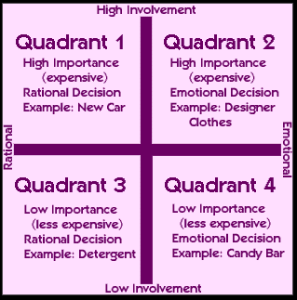
FCB Grid
Notes:
“FCB grid,” is suggested by Dave Berger and Richard Vaughn. This model combines high and low involvement, and left and right brain specialization. It shows a visually coherent matrix which has four quadrants with two factors—high and low involvement, and feeling and thinking.
The communication response would certainly be different for high versus low involvement products and those which required mainly thinking (left brain) and feeling (right brain) information processing. To define involvement and think / feel, eight scales are used:
High Involvement:
Very important decision
Lot to lose if you choose the wrong brand
Decision requires lot
Low involvement :
Unimportant decision.
Little to lose if you choose the wrong brand.
Decision requires little thought
Think or rational approach
Decision is / is not mainly logical or objective
Decision is / is not based mainly on functional facts
Feel or emotional approach
Decision is / is not based on a lot of feeling
Decision does / does not express one’s personality
Decision is / is not based on looks, tastes, touch, smell, or sound (sensory effects)
Kaynak: http://drypen.in/advertising/fcb-grid-model-to-convey-communication-objectives.html

Slide 33
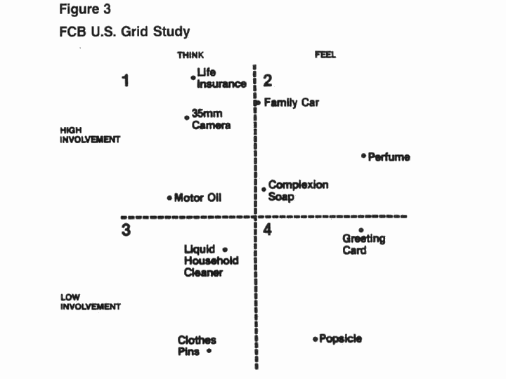
FCB Grid
Notes:
“FCB grid,” is suggested by Dave Berger and Richard Vaughn. This model combines high and low involvement, and left and right brain specialization. It shows a visually coherent matrix which has four quadrants with two factors—high and low involvement, and feeling and thinking.
The communication response would certainly be different for high versus low involvement products and those which required mainly thinking (left brain) and feeling (right brain) information processing. To define involvement and think / feel, eight scales are used:
High Involvement:
Very important decision
Lot to lose if you choose the wrong brand
Decision requires lot
Low involvement :
Unimportant decision.
Little to lose if you choose the wrong brand.
Decision requires little thought
Think or rational approach
Decision is / is not mainly logical or objective
Decision is / is not based mainly on functional facts
Feel or emotional approach
Decision is / is not based on a lot of feeling
Decision does / does not express one’s personality
Decision is / is not based on looks, tastes, touch, smell, or sound (sensory effects)
Kaynak: http://drypen.in/advertising/fcb-grid-model-to-convey-communication-objectives.html

Slide 34
Advertising Theory
Hierarchy of Effects
  Awareness
  Knowledge
  Liking
  Preference
  Conviction
  The Actual Purpose
Notes:
Hierarchy of effects model
It clarifies the objectives of an advertising campaign and for each individual advertisement. The model suggests that there are six steps a consumer or a business buyer moves through when making a purchase

Slide 35
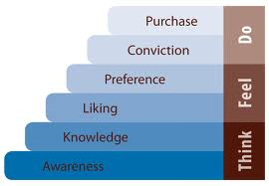
Hierarchy of Effects
Think/Feel/Do

Slide 36
Advertising Theory
Means-End Theory
  The product’s attributes
  Consumer benefits
  Leverage points
  Personal values
  The executional framework
Notes:
Means-End Theory
This approach suggests that an advertisement should contain a message or means that leads the consumer to a desired end state.
Leverage Points
It is designed to move the consumer from understanding a product's benefits to linking those benefits with personal values.

Slide 37
Advertising Theory
Means-End Theory
Personal values
  Comfortable life
  Equality
  Excitement
  Freedom
  Fun, exciting life
  Happiness
  Inner peace
  Mature love
  Personal accomplishment
  Pleasure
  Salvation
  Security
  Self fulfillment
  Self-respect
  Sense of belonging
  Social acceptance
  Wisdom

Slide 38
Advertising Theory
Means-End Theory
Product attribute => Consumer Benefit => Personal Value
  Low fat Healthy Self respect
  Calcium Healthy bones Comfortable life
  Ingredients Good taste Pleasure

